Slide 1
Introduction to Machine Learning
UNIT-I

Slide 2
A Few Quotes
“A breakthrough in machine learning would be worth ten Microsofts” (Bill Gates, Chairman, Microsoft)
“Machine learning is the next Internet” (Tony Tether, Director, DARPA)
Machine learning is the hot new thing” (John Hennessy, President, Stanford)
“Web rankings today are mostly a matter of machine learning” (Prabhakar Raghavan, Dir. Research, Yahoo)
“Machine learning is going to result in a real revolution” (Greg Papadopoulos, CTO, Sun)
“Machine learning is today’s discontinuity” (Jerry Yang, CEO, Yahoo)

Slide 3
What is Machine Learning?
Aspect of AI: creates knowledge
Definition:
“changes in [a] system that ... enable [it] to do the same task or tasks drawn from the same population more efficiently and more effectively the next time.'' (Simon 1983)
There are two ways that a system can improve:
1. By acquiring new knowledge
acquiring new facts
acquiring new skills
2. By adapting its behavior
solving problems more accurately
solving problems more efficiently

Slide 4
What is Learning?
Herbert Simon: “Learning is any process by which a system improves performance from experience.”
What is the task?
Classification
Categorization/clustering
Problem solving / planning / control
Prediction
others

Slide 5
Why Study Machine Learning? Developing Better Computing Systems
Develop systems that are too difficult/expensive to construct manually because they require specific detailed skills or knowledge tuned to a specific task (knowledge engineering bottleneck).
Develop systems that can automatically adapt and customize themselves to individual users.
Personalized news or mail filter
Personalized tutoring
Discover new knowledge from large databases (data mining).
Market basket analysis

Slide 6
Related Disciplines
Artificial Intelligence
Data Mining
Probability and Statistics
Information theory
Numerical optimization
Computational complexity theory
Control theory (adaptive)
Psychology (developmental, cognitive)
Neurobiology
Linguistics
Philosophy

Slide 7
So What Is Machine Learning?
Automating automation
Getting computers to program themselves
Writing software is the bottleneck
Let the data do the work instead!

Slide 8
Machine Learning (ML)
ML is a branch of artificial intelligence:
Uses computing based systems to make sense out of data
Extracting patterns, fitting data to functions, classifying data, etc
ML systems can learn and improve
With historical data, time and experience
Bridges theoretical computer science and real noise data.

Slide 9
Traditional Programming
Machine Learning
Data
Computer
Output
Program
Data
Computer
Program
Output

Slide 10

Magic?
No, more like gardening
Seeds = Algorithms
Nutrients = Data
Gardener = You
Plants = Programs

Slide 11
Sample Applications
Web search
Computational biology
Finance
E-commerce
Space exploration
Robotics
Information extraction
Social networks
Debugging

Slide 12
ML in a Nutshell
Tens of thousands of machine learning algorithms
Hundreds new every year
Every machine learning algorithm has three components:
Representation
Evaluation
Optimization

Slide 13
Why is machine learning necessary?
learning is a hallmark of intelligence; many would argue that a system that cannot learn is not intelligent.
without learning, everything is new; a system that cannot learn is not efficient because it rederives each solution and repeatedly makes the same mistakes.
Why is learning possible?
Because there are regularities in the world.

Slide 14

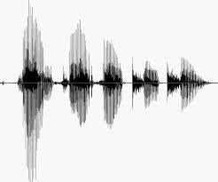
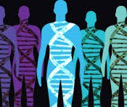
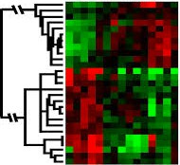
When Do We Use Machine Learning?
ML is used when:
Human expertise does not exist (navigating on Mars)
Humans can’t explain their expertise (speech recognition)
Models must be customized (personalized medicine)
Models are based on huge amounts of data (genomics)
Learning isn’t always useful:
There is no need to “learn” to calculate payroll
Based on slide by E. Alpaydin
5

Slide 15
Representation
Decision trees
Sets of rules / Logic programs
Instances
Graphical models (Bayes/Markov nets)
Neural networks
Support vector machines
Model ensembles
Etc.

Slide 16
Evaluation
Accuracy
Precision and recall
Squared error
Likelihood
Posterior probability
Cost / Utility
Margin
Entropy
K-L divergence
Etc.

Slide 17
Optimization
Combinatorial optimization
E.g.: Greedy search
Convex optimization
E.g.: Gradient descent
Constrained optimization
E.g.: Linear programming

Slide 18
Types of Learning
Supervised (inductive) learning
Training data includes desired outputs
Unsupervised learning
Training data does not include desired outputs
Semi-supervised learning
Training data includes a few desired outputs
Reinforcement learning
Rewards from sequence of actions

Slide 19
ML in Practice
Understanding domain, prior knowledge, and goals
Data integration, selection, cleaning, pre-processing, etc.
Learning models
Interpreting results
Consolidating and deploying discovered knowledge
Loop

Slide 20
Machine Learning as a Process
- Define measurable and quantifiable goals
- Use this stage to learn about the problem
Define Objectives
Data Preparation
Model Building
Model Deployment
Model Evaluation
- Normalization
- Transformation
- Missing Values
- Outliers
Study models accuracy
- Work better than the naïve
approach or previous system
Do the results make sense in the context of the problem
- Data Splitting
Features Engineering
Estimating Performance
Evaluation and Model Selection
Notes:
More formally fits data to a function or a function
Adding Roles

Slide 21
ML as a Process: Data Preparation
Needed for several reasons
Some Models have strict data requirements
Scale of the data, data point intervals, etc
Some characteristics of the data may impact dramatically on the model performance
Raw Data
Data Transformation
Data Ready
Scaling
Centering
Skewness
Outliers
Missing Values
Errors
Missing Values
Dimensionality
Types Problems
Error Values
Different Scales
Many others
Modeling phase
Notes:
Add Examples

Slide 22
ML as a Process: Feature engineering
Determine the predictors (features) to be used is one of the most critical questions
Some times we need to add predictors
Reduce Number:
Fewer predictors more interpretable model and less costly
Most of the models are affected by high dimensionality, specially for non-informative predictors
Binning predictors
Wrappers
Multiple models adding and removing parameter
Filters
Evaluate the relevance of the predictor
Based normally on correlations
Algorithms that use models as input and performance as output
Genetics Algorithms
Notes:
Random Forest (tree based) MARS and LASSO internally perform predictor selection
Add Examples

Slide 23
ML as a Process: Model Building
Data Splitting
Allocate data to different tasks
model training
performance evaluation
Define Training, Validation and Test sets
Feature Selection (Review the decision made previously)
Estimating Performance
Visualization of results – discovery interesting areas of the problem space
Statistics and performance measures
Evaluation and Model selection
The ‘no free lunch’ theorem no a priory assumptions can be made
Avoid use of favorite models if NEEDED
Notes:
there is no one single model that will works better than any other a priory

Slide 24
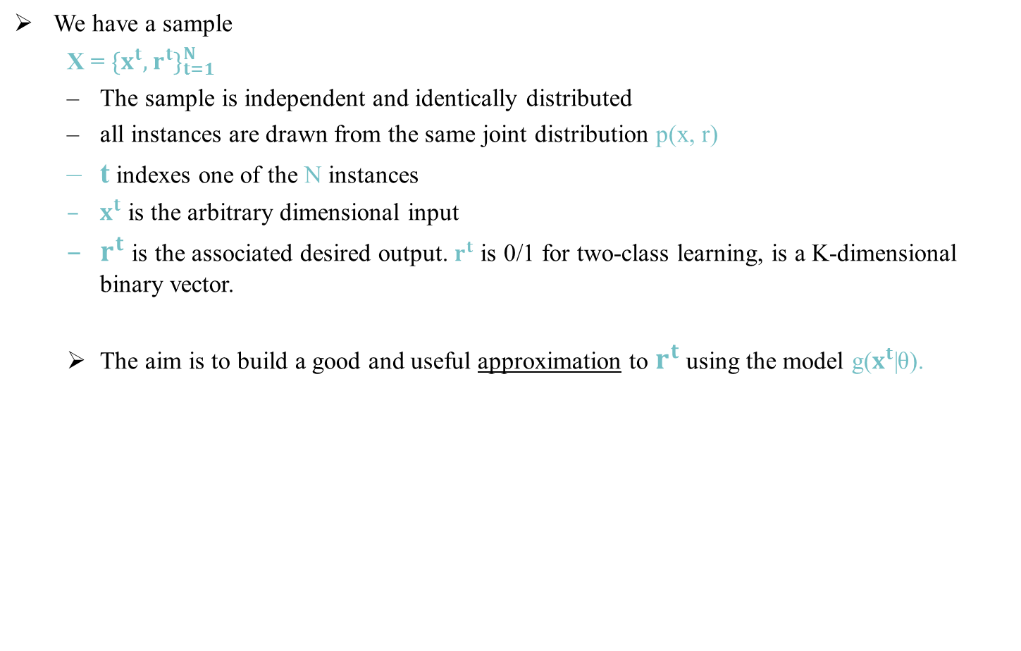
Dimensions of a Supervised Machine Learning Algorithms
@Copyrights: Machine Learning Organized by Dr. Ahmad Jalal (http://portals.au.edu.pk/imc/)

Slide 25
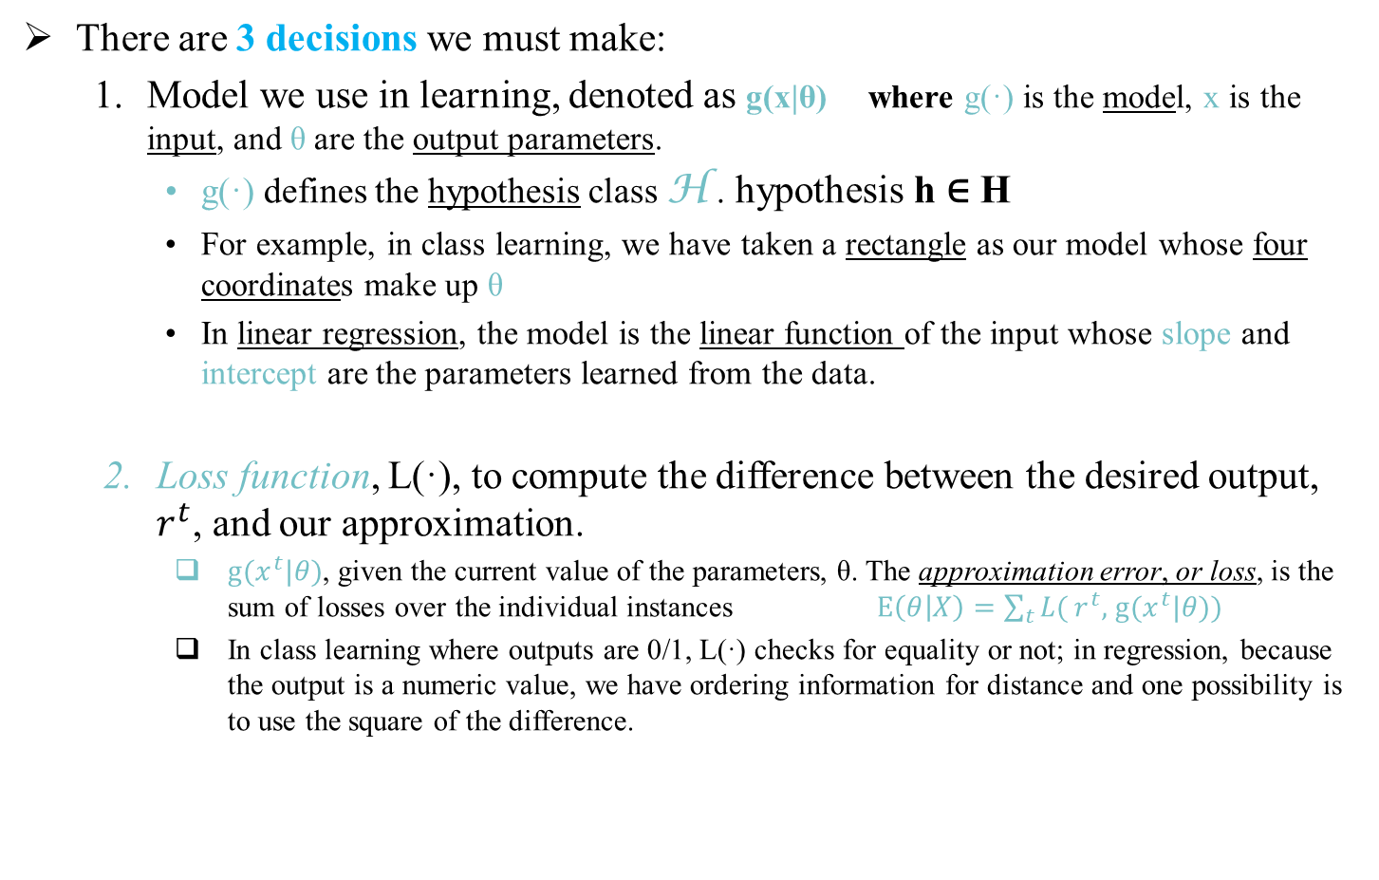

Dimensions of a Supervised Machine Learning Algorithms
(Cont…)
@Copyrights: Machine Learning Organized by Dr. Ahmad Jalal (http://portals.au.edu.pk/imc/)

Slide 26
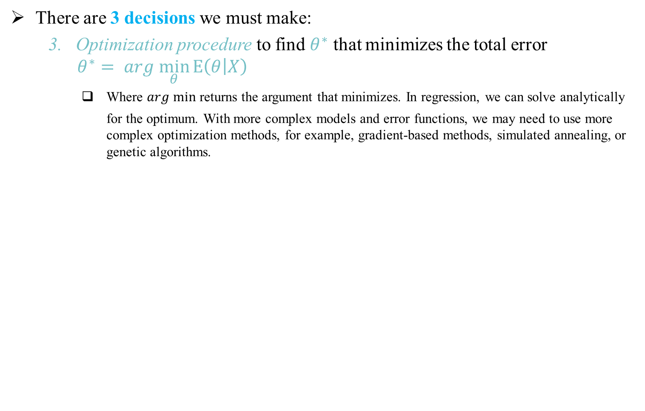
Dimensions of a Supervised Machine Learning Algorithms
(Cont…)
@Copyrights: Machine Learning Organized by Dr. Ahmad Jalal (http://portals.au.edu.pk/imc/)

Slide 27
Well-posed Learning Problems
Def 1 (Mitchell 1997):
A computer program is said to learn from experience E with respect to some class of tasks T and performance measure P, if its performance at tasks in T, as measured by P, improves by experience E.
Def 2 (Hadamard 1902):
A (machine learning) problem is well-posed if a solution to it exists, if that solution is unique, and if that solution depends on the data / experience but it is not sensitive to (reasonably small) changes in the data / experience.

Slide 28
Designing a Machine Learning System
Target Function V represents the problem to be solved
(e.g., choosing the best next move in chess, identifying people, classifying facial expressions into emotion categories)
Well-posed Problem?
V: D → C where D is the input state space and C is the set of classes
V: D → [-1, 1] is a general target function of a binary classifier
Determine type of training examples
Determine Target Function
Ideal Target Function is usually not known; machine learning algorithms learn an approximation of V, say V’
Representation of function V’ to be learned should
Choose Target F-on Representation
be as close an approximation of V as possible
require (reasonably) small amount of training data to be learned
Choose Learning Algorithm
V’(d) = w₀ + w₁x₁ +…+ w_{n}x_{n} where ‹x₁…x_{n}› ≡ d ∈ D is an input state. This reduces the problem to learning (the most optimal) weights w.

Slide 29
Designing a Machine Learning System
V: D → C where D is the input state and C is the set of classes
V: D → [-1, 1] is a general target function of a binary classifier
Well-posed Problem?
V’(d) = w + w x +…+ w x where ‹x …x › ≡ d ∈ D is an input state.
0 1 1 n n 1 n
This reduces the problem to learning (the most optimal) weights w.
Determine type of training examples
Training examples suitable for the given target function representation V’ are pairs ‹d, c› where c ∈ C is the desired output (classification) of the input state d ∈ D.
Learning algorithm learns the most optimal set of weights w (so-called best hypothesis), i.e., the set of weights that best fit the training examples ‹d, c›.
Determine Target Function
Choose Target F-on Representation
Learning algorithm is selected based on the availability of training examples (supervised vs. unsupervised), knowledge of the final set of classes C (offline vs. online, i.e., eager vs. lazy), availability of a tutor (reinforcement learning).
Choose Learning Algorithm
The learned V’ is then used to solve new instances of the problem.

Slide 30
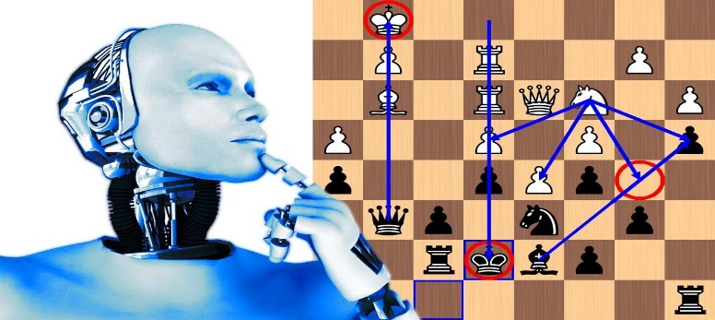
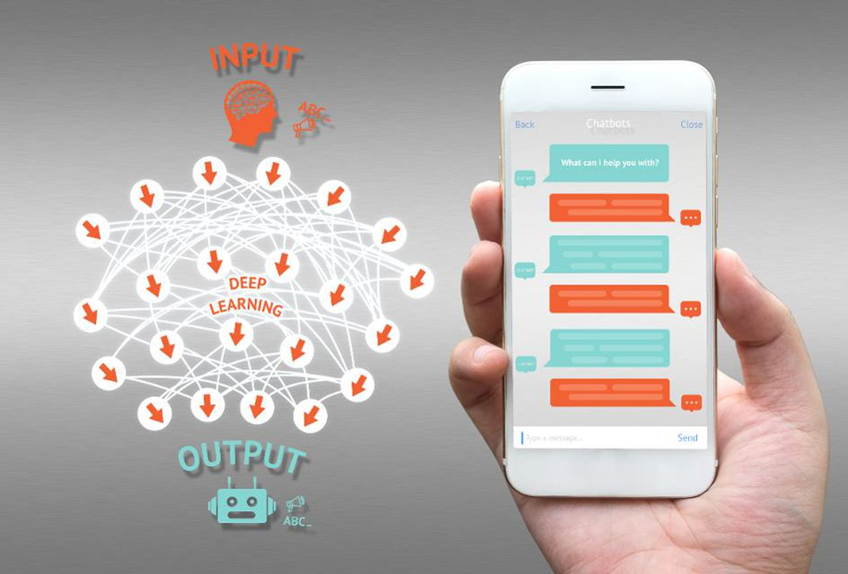
Examples of Well-posed Learning Problems
(1) Game Automation:
-the ability of computer to automatically learn and improve from experience without being explicitly programmed.
For Example
Learning play checkers game to improve its automation.
Experience = games against itself,
Performance P = win or lost (percentage).
(2) NLP-based word recognizer:
Learning to recognize spoken words.
- Experience = words data,
- Performance = percentage of correct recognize word.
@Copyrights: Machine Learning Organized by Dr. Ahmad Jalal (http://portals.au.edu.pk/imc/)

Slide 31
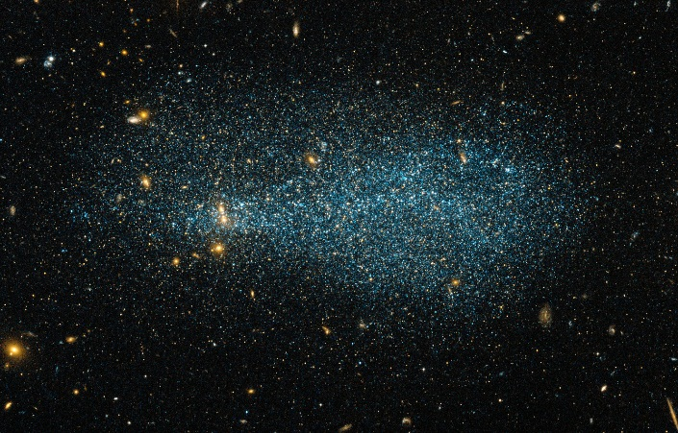
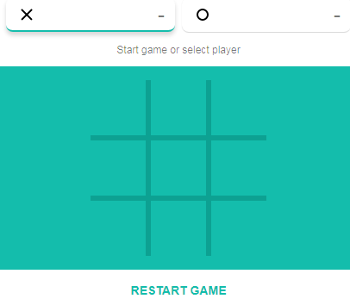
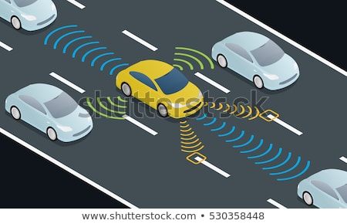
Examples of Well-posed Learning Problems (Cont…)
(3) Astronomical structures:
Learning to classify new astronomical structures
- Experience = images,
- Performance = percent of correct classification.
(4) Tic-Tac-Toe:
Learning to play world-class Tic-Tac-Toe.
- Experience = against itself (million practices),
- Performance = percent of win.
(5) Robot driving learning problem:
Task=driving (on public highway using sensor).
- Experience = sequence of images and steering command (during drive),
- Performance = average distance (before error).
@Copyrights: Machine Learning Organized by Dr. Ahmad Jalal (http://portals.au.edu.pk/imc/)

Slide 32
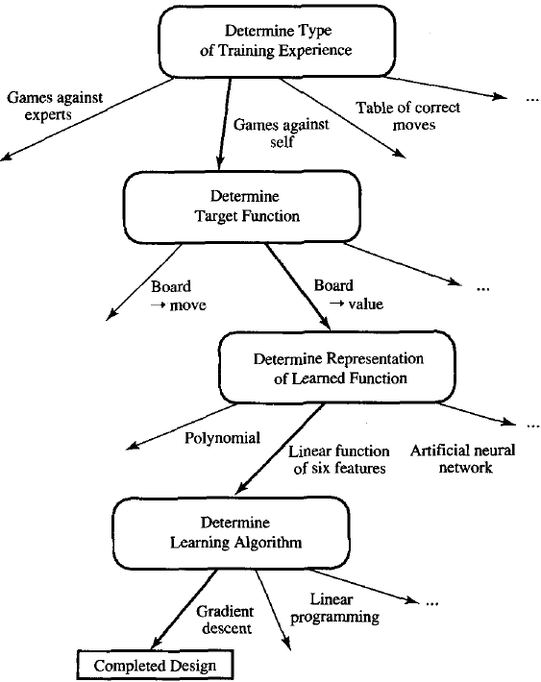
Designing a Learning System
Direct
training
Understand approaches to machine learning.
Understand basic design issues.
For Example:
Consider designing a program to learn to play checkers game.
inDirect
training
InDirect
training
@Copyrights: Machine Learning Organized by Dr. Ahmad Jalal (http://portals.au.edu.pk/imc/)

Slide 33
Determine Type of Training Experience
Training experience have significant impact on success or failure of learner
(a) Direct Training:
- In checker play game; training example consist of individual board state and gives the right move for this state.
- e.g., tables of correct moves.
(b) Indirect Training:
- It has only indirect information consisting of move sequences and final outcomes.
- e.g., games against experts or games against self.
Impact:
Learner can use these training example to understand state which learner feel confusing. e.g., “Is King save during next move”.
Learner can use training example for novel state(which has not discovered). e.g., “unexpected moves” or “surprised moves”.
Performance depend how well our training experience represent the distribution of example.
@Copyrights: Machine Learning Organized by Dr. Ahmad Jalal (http://portals.au.edu.pk/imc/)

Slide 34
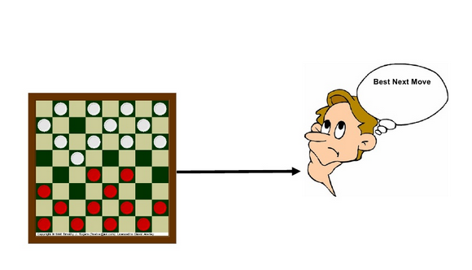
Determine Target Function
The target function’s job is to choose the best move from the given moves.
- Lets call this function “Choose Move”.
For Example:
Choose Move: B -> M
it take board state as input B .
give the best move (from legal move).
@Copyrights: Machine Learning Organized by Dr. Ahmad Jalal (http://portals.au.edu.pk/imc/)

Slide 35
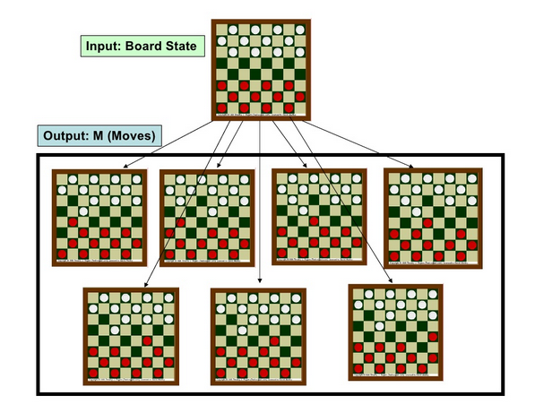
Determine Target Function (Cont…)
During Indirect experience;
- it is difficult to compute best move.
@Copyrights: Machine Learning Organized by Dr. Ahmad Jalal (http://portals.au.edu.pk/imc/)

Slide 36
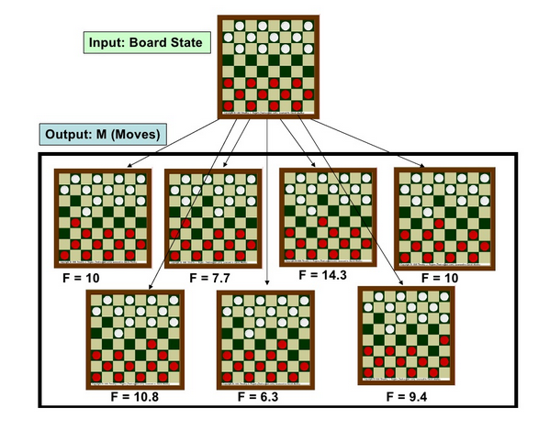
Determine Target Function (Cont…)
The replaced “choose move” function by V : B -> R
V is target function.
B is the set of legal move.
Output R denotes a set of real number.
This function assign real value to every legal move. it give high value to every better move (ranking states with real number).
The values of states will increase when we go near to win.
The values of states will decrease when we go near to loss.
if game is won then v(b) = 100
if game is lost then v(b) = -100
if game is equal then v(b) = 0
Function “V” will choose the state with higher score.
@Copyrights: Machine Learning Organized by Dr. Ahmad Jalal (http://portals.au.edu.pk/imc/)

Slide 37
Determine Representation of Learned Function
Case: “If Function V is not efficient”
So, we Create function V^ which is an approximation to V.
Parameter of function V^ given bellow.
x₁: number of white pieces
x₂: number of red pieces
x₃: number of white kings
x₄: number of red kings
x₅: number of white pieces threatened by red
(i.e., which can be captured on red's next turn)
x₆: number of red pieces threatened by white
The linear function V^(b) is in Form;
where w₀ through w₆ are numerical coefficients, or weights, to be chosen by the learning algorithm.
@Copyrights: Machine Learning Organized by Dr. Ahmad Jalal (http://portals.au.edu.pk/imc/)

Slide 38
Determine Learning Algorithm
Training information:
we only have information about game win or lost.
Requirement:
but we need training example to assign specific score to specific board state.
Problems occurs during assigning score:
how to assign score to intermediate board states that occur before the game's end. For example:
If game won:
Doesn't mean that every board state along the game path was good.
If game lost:
Doesn't mean that every board state along the game path was bad.
@Copyrights: Machine Learning Organized by Dr. Ahmad Jalal (http://portals.au.edu.pk/imc/)

Slide 39
Estimating Training Values
Learn the target:
- for learning function V^, we require a set of training examples, each describing a specific board state b and the training value V.
training example given in following format
tuple<b,Vtrain(b)>
b is state
Vtrain(b) is training value for b
Training information:
we only have information about game win or lost.
Requirement:
but we need training example to assign specific score to specific board state.
@Copyrights: Machine Learning Organized by Dr. Ahmad Jalal (http://portals.au.edu.pk/imc/)

Slide 40
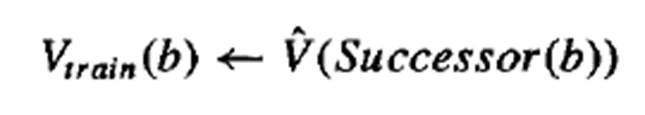
Estimating Training Values (Cont…)
Problems occurs during assigning score:
how to assign score to intermediate board states that occur before the game's end. For Example;
If game won:
Doesn't mean that every board state along the game path was good.
If game lost:
Doesn't mean that every board state along the game path was bad.
Solution (Score for intermediate states):
Assign the Vtrain (for any state that occur between start and end of the game) to V^(successor (b)) .
Rule for estimating training values.
@Copyrights: Machine Learning Organized by Dr. Ahmad Jalal (http://portals.au.edu.pk/imc/)

Slide 41
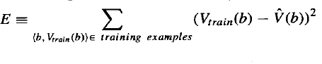
Adjusting the Weights
We select the weight which is best fit to train data, best fit minimum value of E
We must select the algorithm which decrease the E every time and one such algorithm is Least Mean Algorithm (LMA).
Target value
Output value
@Copyrights: Machine Learning Organized by Dr. Ahmad Jalal (http://portals.au.edu.pk/imc/)

Slide 42
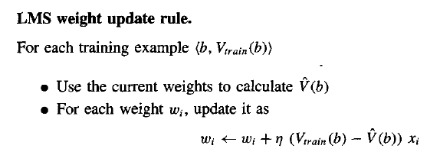
5.4.2 Adjusting the Weights (Example)
With Error = Change in weight
w1=w1+n(vt(b)-vo(b))x1
w1=3 , n=0.1
w1=w1+0.1(25-20)(3)
w1=3+1.5
W1=4.5
Change due to error
error
Without Error = no Change in weight
w1=w1+n(vt(b)-vo(b))x1
w1=3 , n=0.1
w1=w1+(0.1)(25-25)(3)
w1=3+0
W1=3
No change because no error
No error
@Copyrights: Machine Learning Organized by Dr. Ahmad Jalal (http://portals.au.edu.pk/imc/)

Slide 43
What is STL?
“The goal of statistical learning theory is to study, in a statistical framework, the properties of learning algorithms”
– [Bousquet et.al., 04]

Slide 44
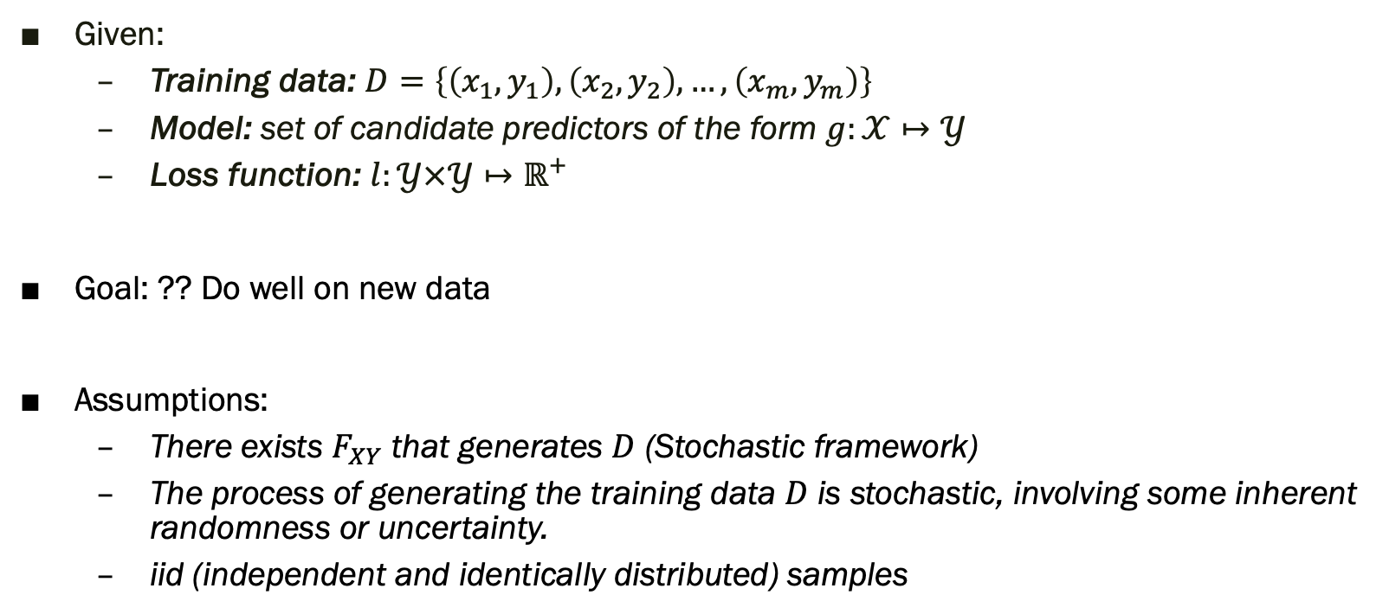
Supervised Learning Setting
Given:
Training data: $D=\left\{\left(x_{1},y_{1}\right),\left(x_{2},y_{2}\right), …,\left(x_{m},y_{m}\right)\right\}$
Model: set of candidate predictors of the form $g:𝒳↦𝒴$
Loss function: $l:𝒴×𝒴↦ℝ^{+}$
Goal: ?? Do well on new data
Assumptions:
There exists $F_{XY}$ that generates $D$ (Stochastic framework)
The process of generating the training data $D$ is stochastic, involving some inherent randomness or uncertainty.
iid (independent and identically distributed) samples

Slide 45
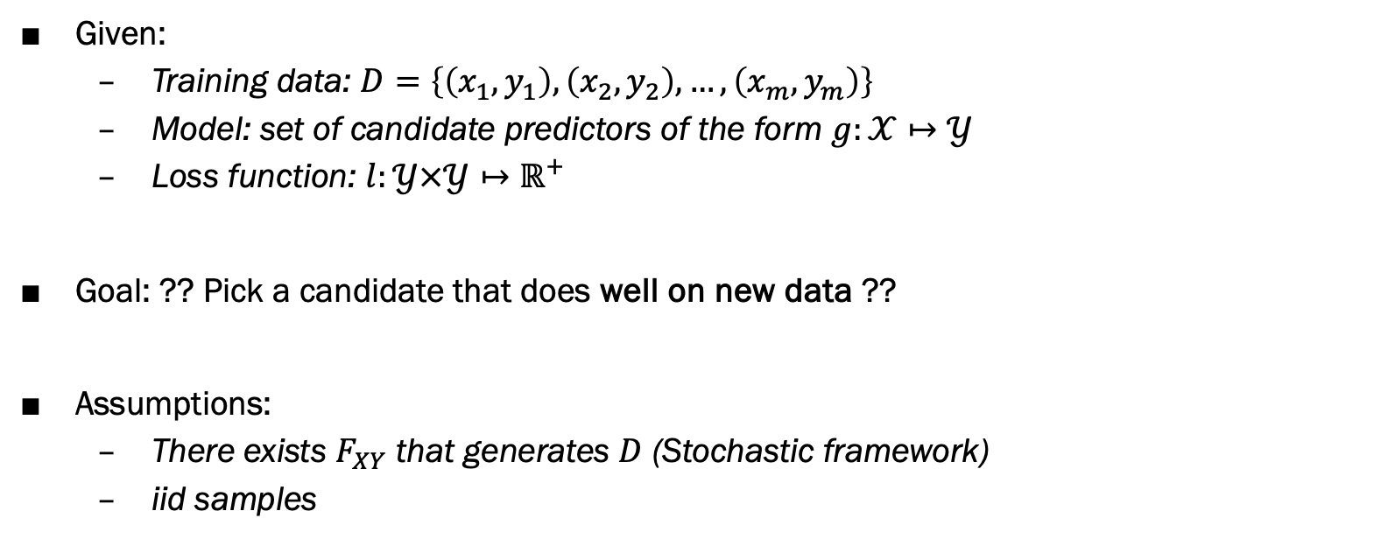
Supervised Learning Setting
Given:
Training data: $D=\left\{\left(x_{1},y_{1}\right),\left(x_{2},y_{2}\right), …,\left(x_{m},y_{m}\right)\right\}$
Model: set of candidate predictors of the form $g:𝒳↦𝒴$
Loss function: $l:𝒴×𝒴↦ℝ^{+}$
Goal: ?? Pick a candidate that does well on new data ??
Assumptions:
There exists $F_{XY}$ that generates $D$ (Stochastic framework)
iid samples

Slide 46
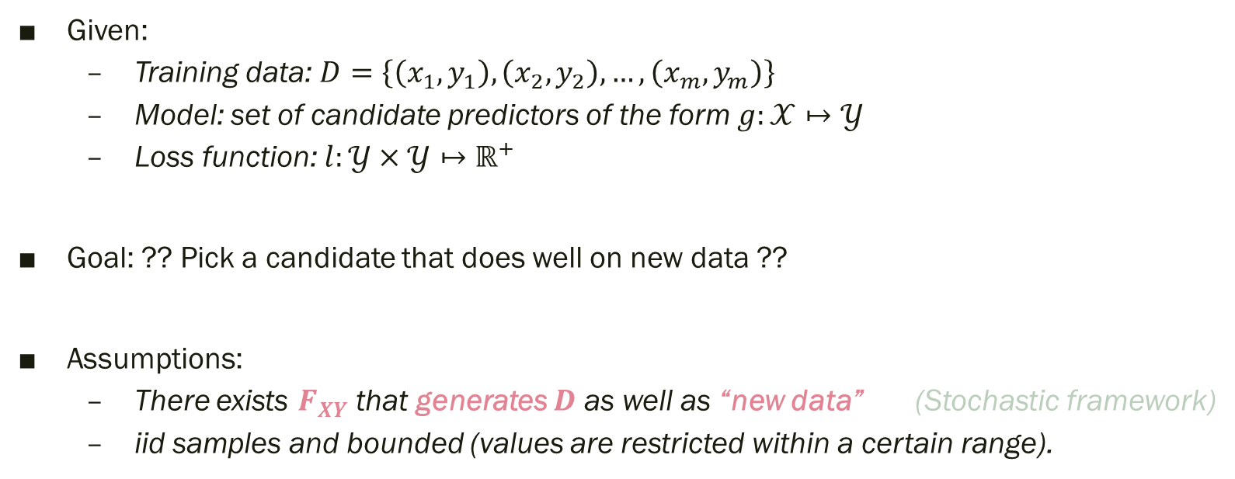
Supervised Learning Setting
Given:
Training data: $D=\left\{\left(x_{1},y_{1}\right),\left(x_{2},y_{2}\right), …,\left(x_{m},y_{m}\right)\right\}$
Model: set of candidate predictors of the form $g:𝒳↦𝒴$
Loss function: $l:𝒴×𝒴↦ℝ^{+}$
Goal: ?? Pick a candidate that does well on new data ??
Assumptions:
There exists $F_{XY}$ that generates $D$ as well as “new data” (Stochastic framework)
iid samples and bounded (values are restricted within a certain range).

Slide 47
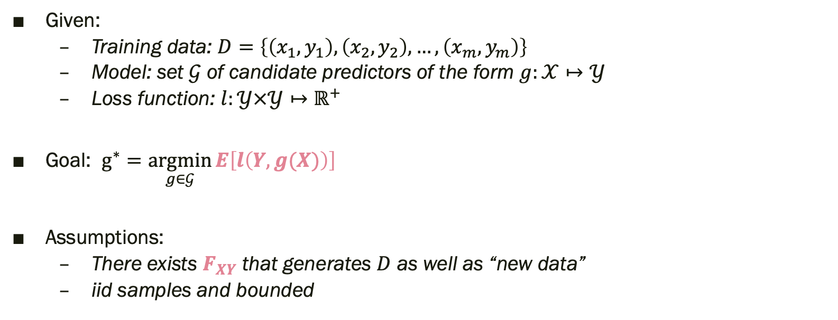
Supervised Learning Setting
Given:
Training data: $D=\left\{\left(x_{1},y_{1}\right),\left(x_{2},y_{2}\right), …,\left(x_{m},y_{m}\right)\right\}$
Model: set $𝒢$ of candidate predictors of the form $g:𝒳↦𝒴$
Loss function: $l:𝒴×𝒴↦ℝ^{+}$
Goal: $g^{∗}=\underset{g∈𝒢}{argmin}{E\left[l\left(Y,g(X)\right)\right]}$
Assumptions:
There exists $F_{XY}$ that generates $D$ as well as “new data”
iid samples and bounded

Slide 48

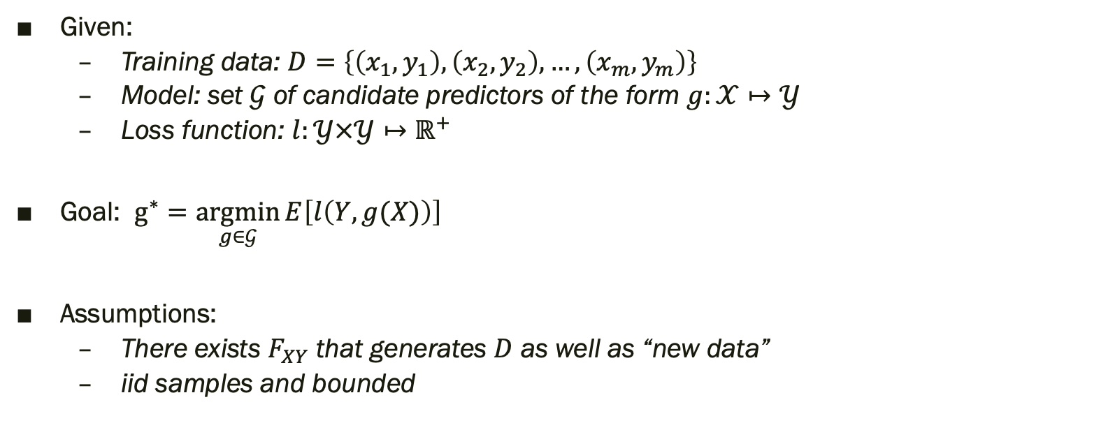
Supervised Learning Setting
Given:
Training data: $D=\left\{\left(x_{1},y_{1}\right),\left(x_{2},y_{2}\right), …,\left(x_{m},y_{m}\right)\right\}$
Model: set $𝒢$ of candidate predictors of the form $g:𝒳↦𝒴$
Loss function: $l:𝒴×𝒴↦ℝ^{+}$
Goal: $g^{∗}=\underset{g∈𝒢}{argmin}{E\left[l\left(Y,g(X)\right)\right]}$
Assumptions:
There exists $F_{XY}$ that generates $D$ as well as “new data”
iid samples and bounded
Minimize expected loss
(a.k.a. risk $R_{l}[g]$ minimization)

Slide 49
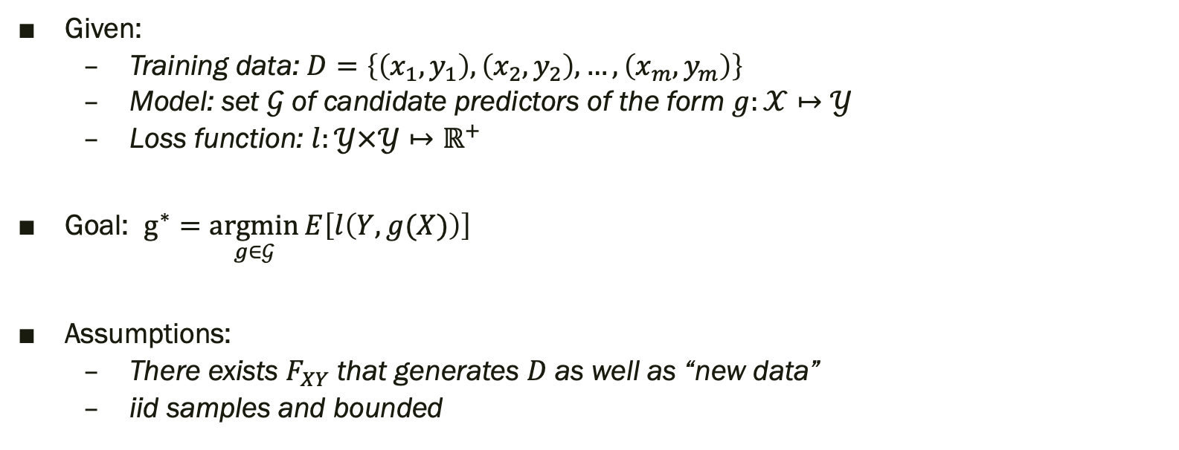
Supervised Learning Setting
Given:
Training data: $D=\left\{\left(x_{1},y_{1}\right),\left(x_{2},y_{2}\right), …,\left(x_{m},y_{m}\right)\right\}$
Model: set $𝒢$ of candidate predictors of the form $g:𝒳↦𝒴$
Loss function: $l:𝒴×𝒴↦ℝ^{+}$
Goal: $g^{∗}=\underset{g∈𝒢}{argmin}{E\left[l\left(Y,g(X)\right)\right]}$
Assumptions:
There exists $F_{XY}$ that generates $D$ as well as “new data”
iid samples and bounded
Well-defined, but un-realizable.

Slide 50
Supervised Learning Setting
Given:
Training data: $D=\left\{\left(x_{1},y_{1}\right),\left(x_{2},y_{2}\right), …,\left(x_{m},y_{m}\right)\right\}$
Model: set $𝒢$ of candidate predictors of the form $g:𝒳↦𝒴$
Loss function: $l:𝒴×𝒴↦ℝ^{+}$
Goal: $g^{∗}=\underset{g∈𝒢}{argmin}{E\left[l\left(Y,g(X)\right)\right]}$
Assumptions:
There exists $F_{XY}$ that generates $D$ as well as “new data”
iid samples and bounded
How well can we approximate?

Slide 51
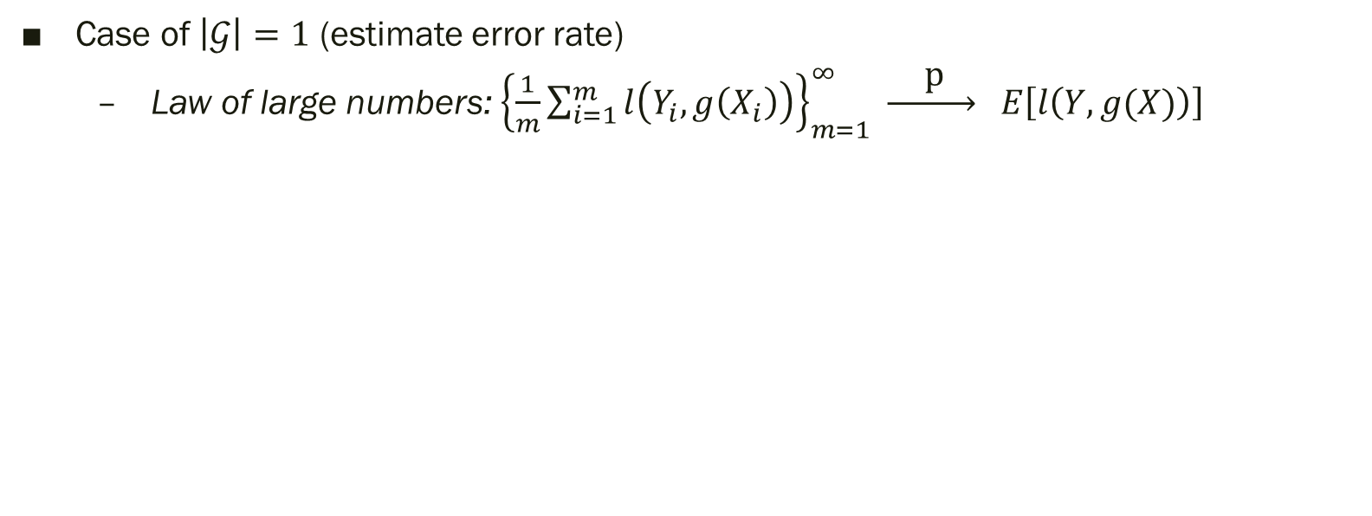
Skyline ?
Case of $\left|𝒢\right|=1$ (estimate error rate)
Law of large numbers: ${\left\{\frac{1}{m}\sum_{i=1}^{m}{l\left(Y_{i},g\left(X_{i}\right)\right)}\right\}}_{m=1}^{∞} \underset{→}{ \text{p} } E\left[l\left(Y,g(X)\right)\right]$
With high probability,
average loss (a.k.a. empirical risk)
on (a large) training set is a good approximation for risk
The law of large numbers states that, with a sufficiently large number of samples ($m$ approaching infinity), the sample mean converges to the true population mean.

Slide 52
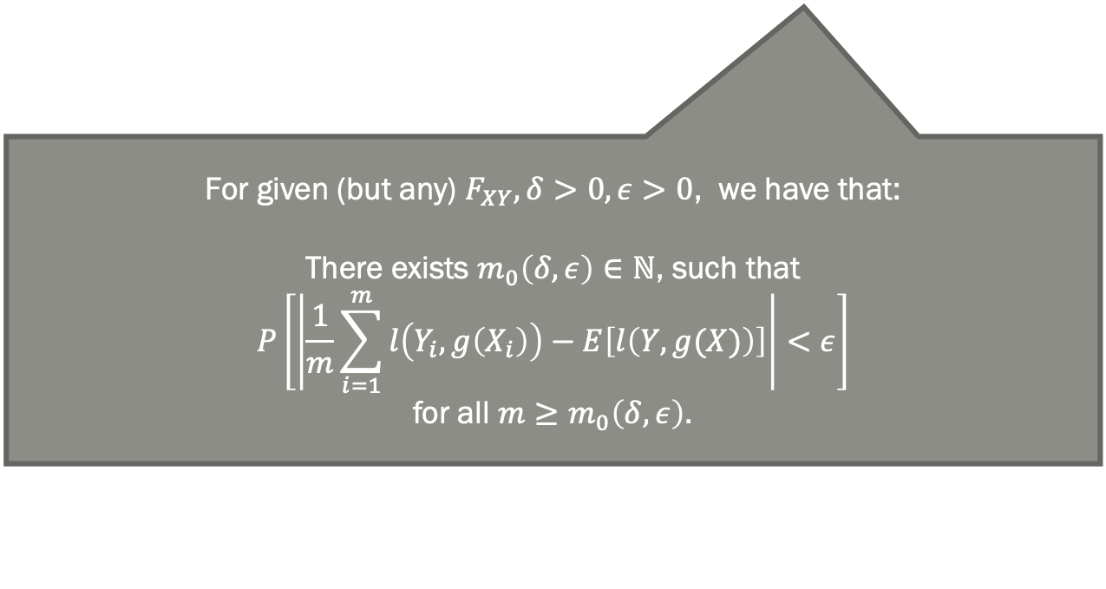
Skyline ?
The LLN states that, with a sufficiently large number of samples, the sample mean converges to the true population mean. In the context of empirical risk minimization, this means that the average loss (empirical risk) on a large training set converges to the true expected risk.
Case of $\left|𝒢\right|=1$ (estimate error rate)
Law of large numbers: ${\left\{\frac{1}{m}\sum_{i=1}^{m}{l\left(Y_{i},g\left(X_{i}\right)\right)}\right\}}_{m=1}^{∞} \underset{→}{ \text{p} } E\left[l\left(Y,g(X)\right)\right]$
For given (but any) $F_{XY},δ>0,ε>0$, we have that:
There exists $m_{0}\left(δ,ε\right)∈ℕ$, such that
$$P\left[\left|\frac{1}{m}\sum_{i=1}^{m}{l\left(Y_{i},g\left(X_{i}\right)\right)}−E\left[l\left(Y,g(X)\right)\right]\right|<ε\right]$$
for all $m≥m_{0}\left(δ,ε\right)$.

Slide 53
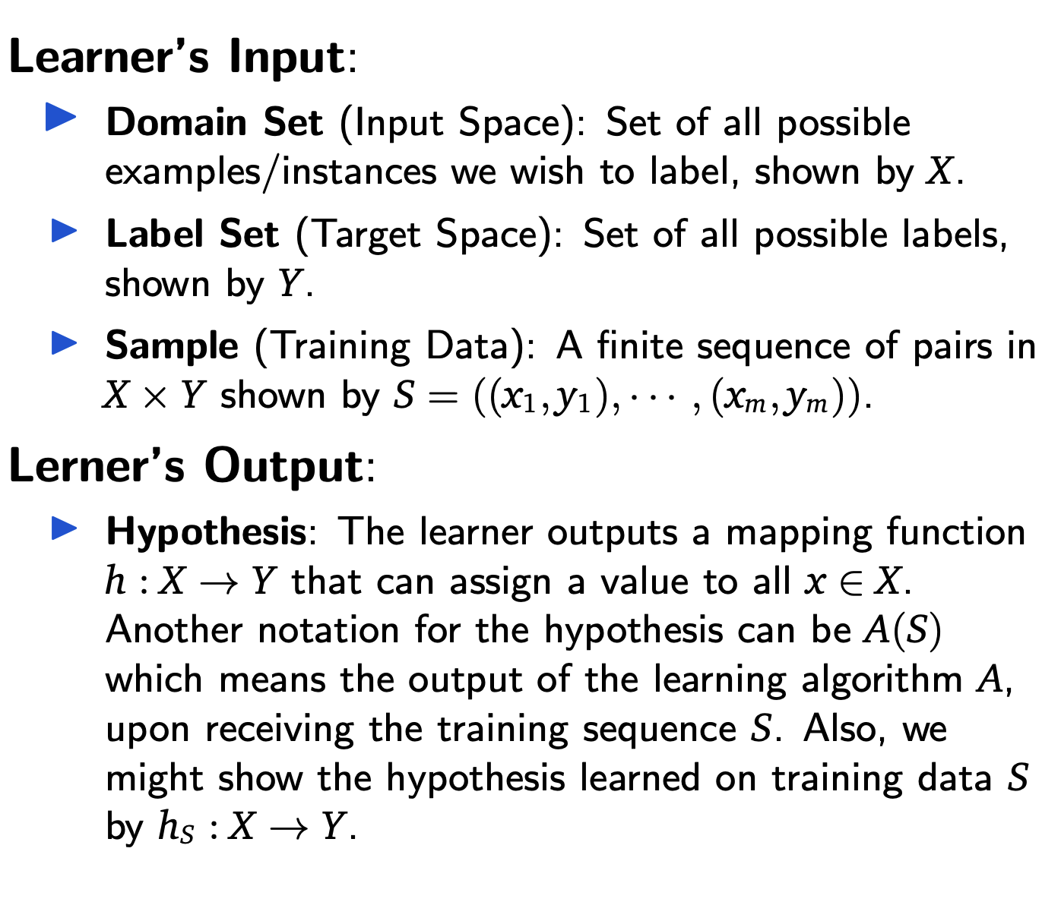
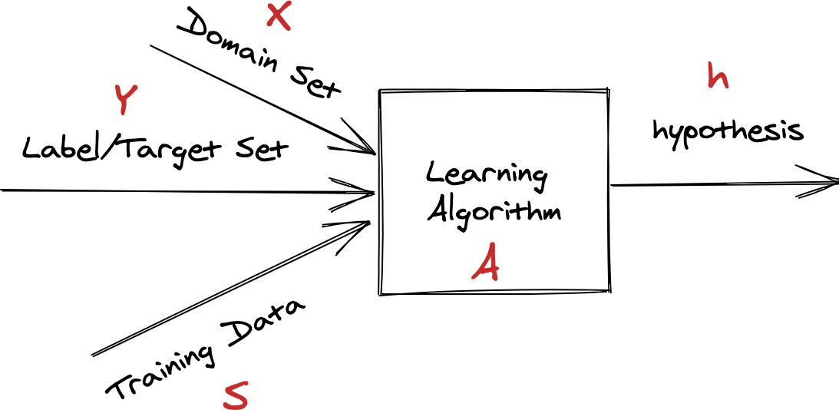
Statistical Learning Framework
Learner’s Input:
Domain Set (Input Space): Set of all possible examples/instances we wish to label, shown by X.
Label Set (Target Space): Set of all possible labels, shown by Y.
Sample (Training Data): A finite sequence of pairs in
X × Y shown by S = ((x1, y1), · · · , (xm, ym)).
Lerner’s Output:
Hypothesis: The learner outputs a mapping function h : X → Y that can assign a value to all x ∈ X. Another notation for the hypothesis can be A(S) which means the output of the learning algorithm A, upon receiving the training sequence S. Also, we might show the hypothesis learned on training data S by hS : X → Y.
6

Slide 54
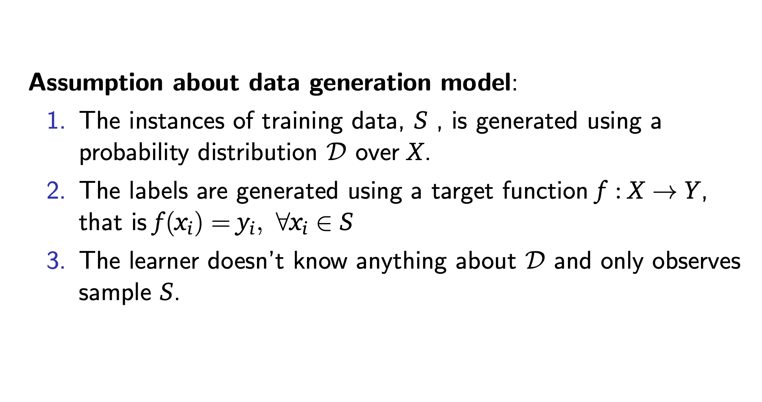
Statistical Learning Framework (2)
Assumption about data generation model:
The instances of training data, S , is generated using a probability distribution D over X.
The labels are generated using a target function f : X → Y, that is f (x_{i}) = y_{i}, ∀x_{i} ∈ S
The learner doesn’t know anything about D and only observes sample S.
7

Slide 55
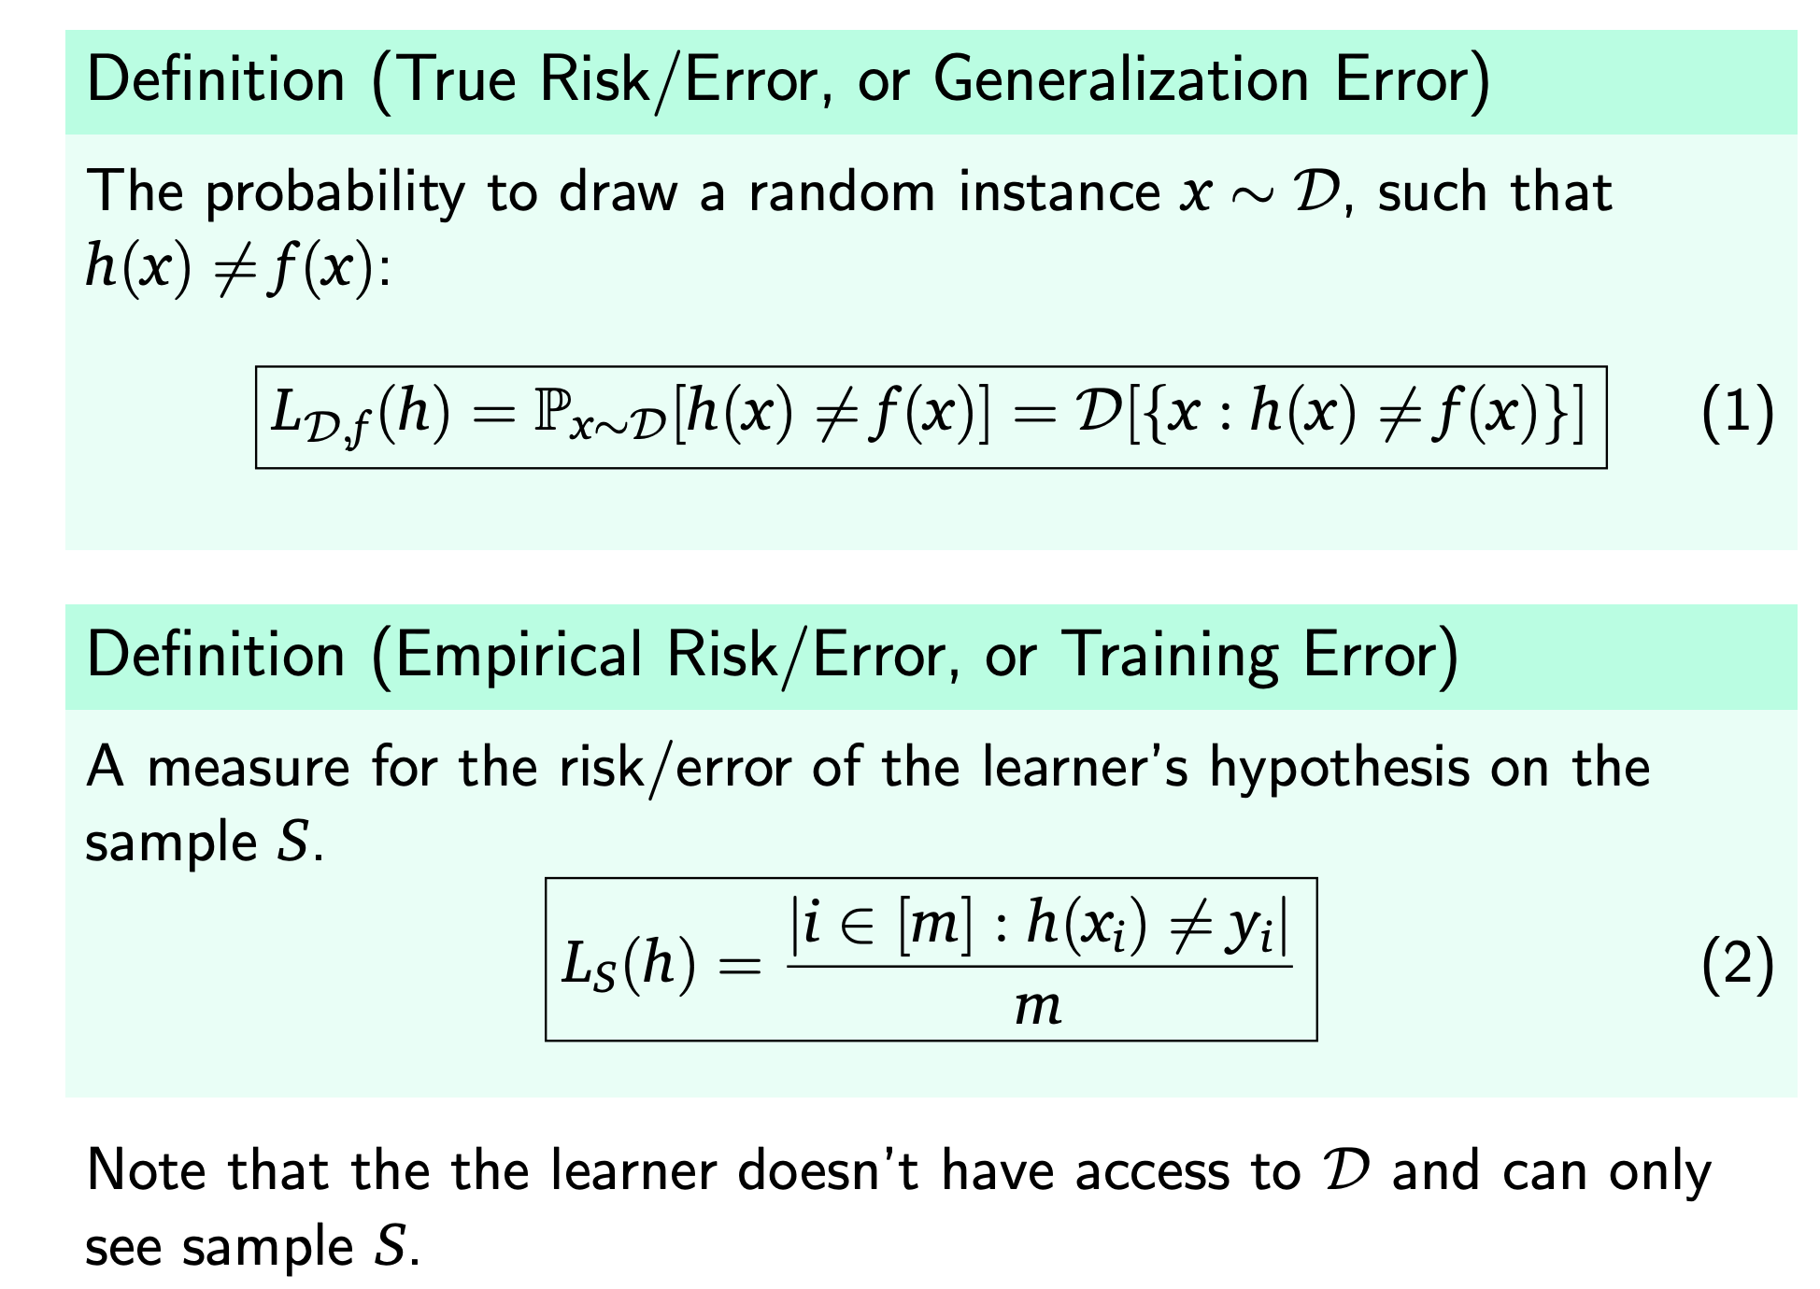
Measures of Success
Definition (True Risk/Error, or Generalization Error)
The probability to draw a random instance x ∼ D, such that
h(x) /= f (x):
L_{D,f} (h) = P_{x∼D}[h(x) =/ f (x)] = D[{x : h(x) /= f (x)}] (1)
Definition (Empirical Risk/Error, or Training Error)
A measure for the risk/error of the learner’s hypothesis on the sample S.
_{LS(h) =} |i ∈ [m] : h(x_{i}) =/ y_{i}|
(2)
m
Note that the the learner doesn’t have access to D and can only
see sample S.
8

Slide 56
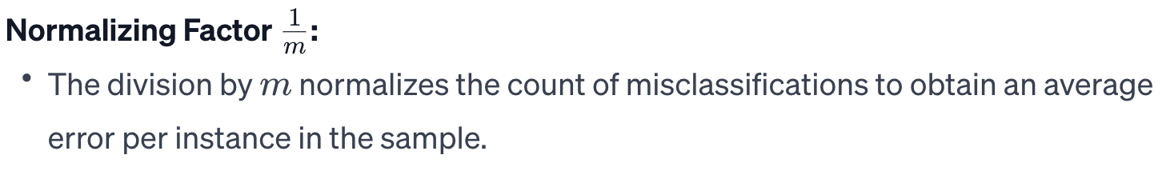
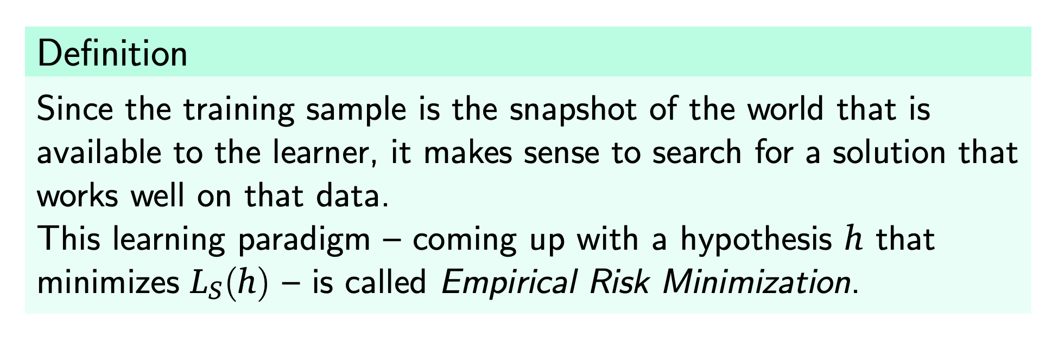
Empirical Risk Minimization (ERM)
Definition
Since the training sample is the snapshot of the world that is available to the learner, it makes sense to search for a solution that works well on that data.
This learning paradigm – coming up with a hypothesis h that minimizes L_{S}(h) – is called Empirical Risk Minimization.

Slide 57
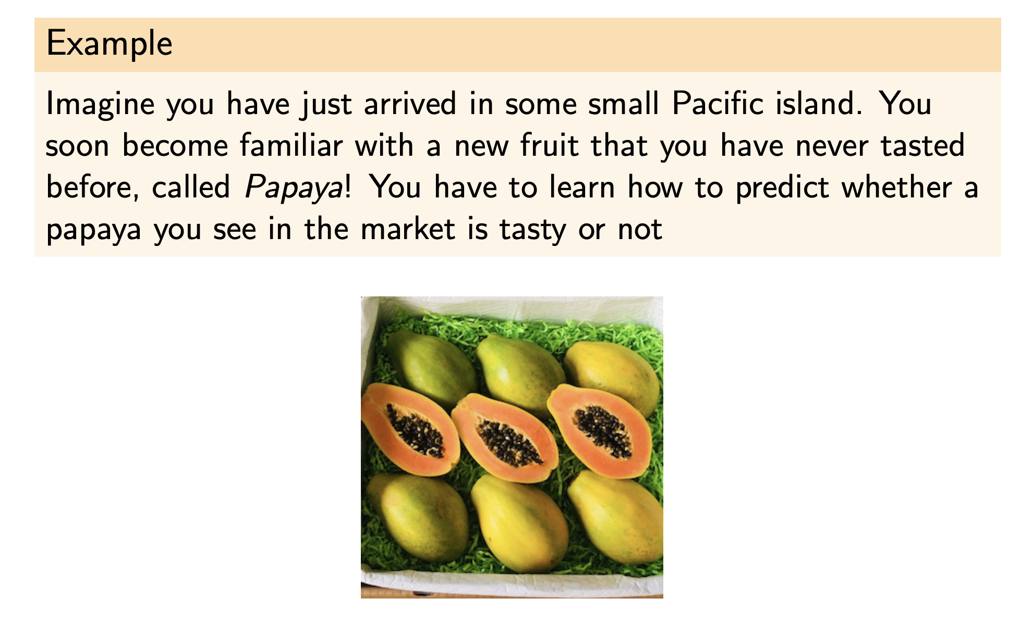
Papayas Example
Example
Imagine you have just arrived in some small Pacific island. You soon become familiar with a new fruit that you have never tasted before, called Papaya! You have to learn how to predict whether a papaya you see in the market is tasty or not
11

Slide 58
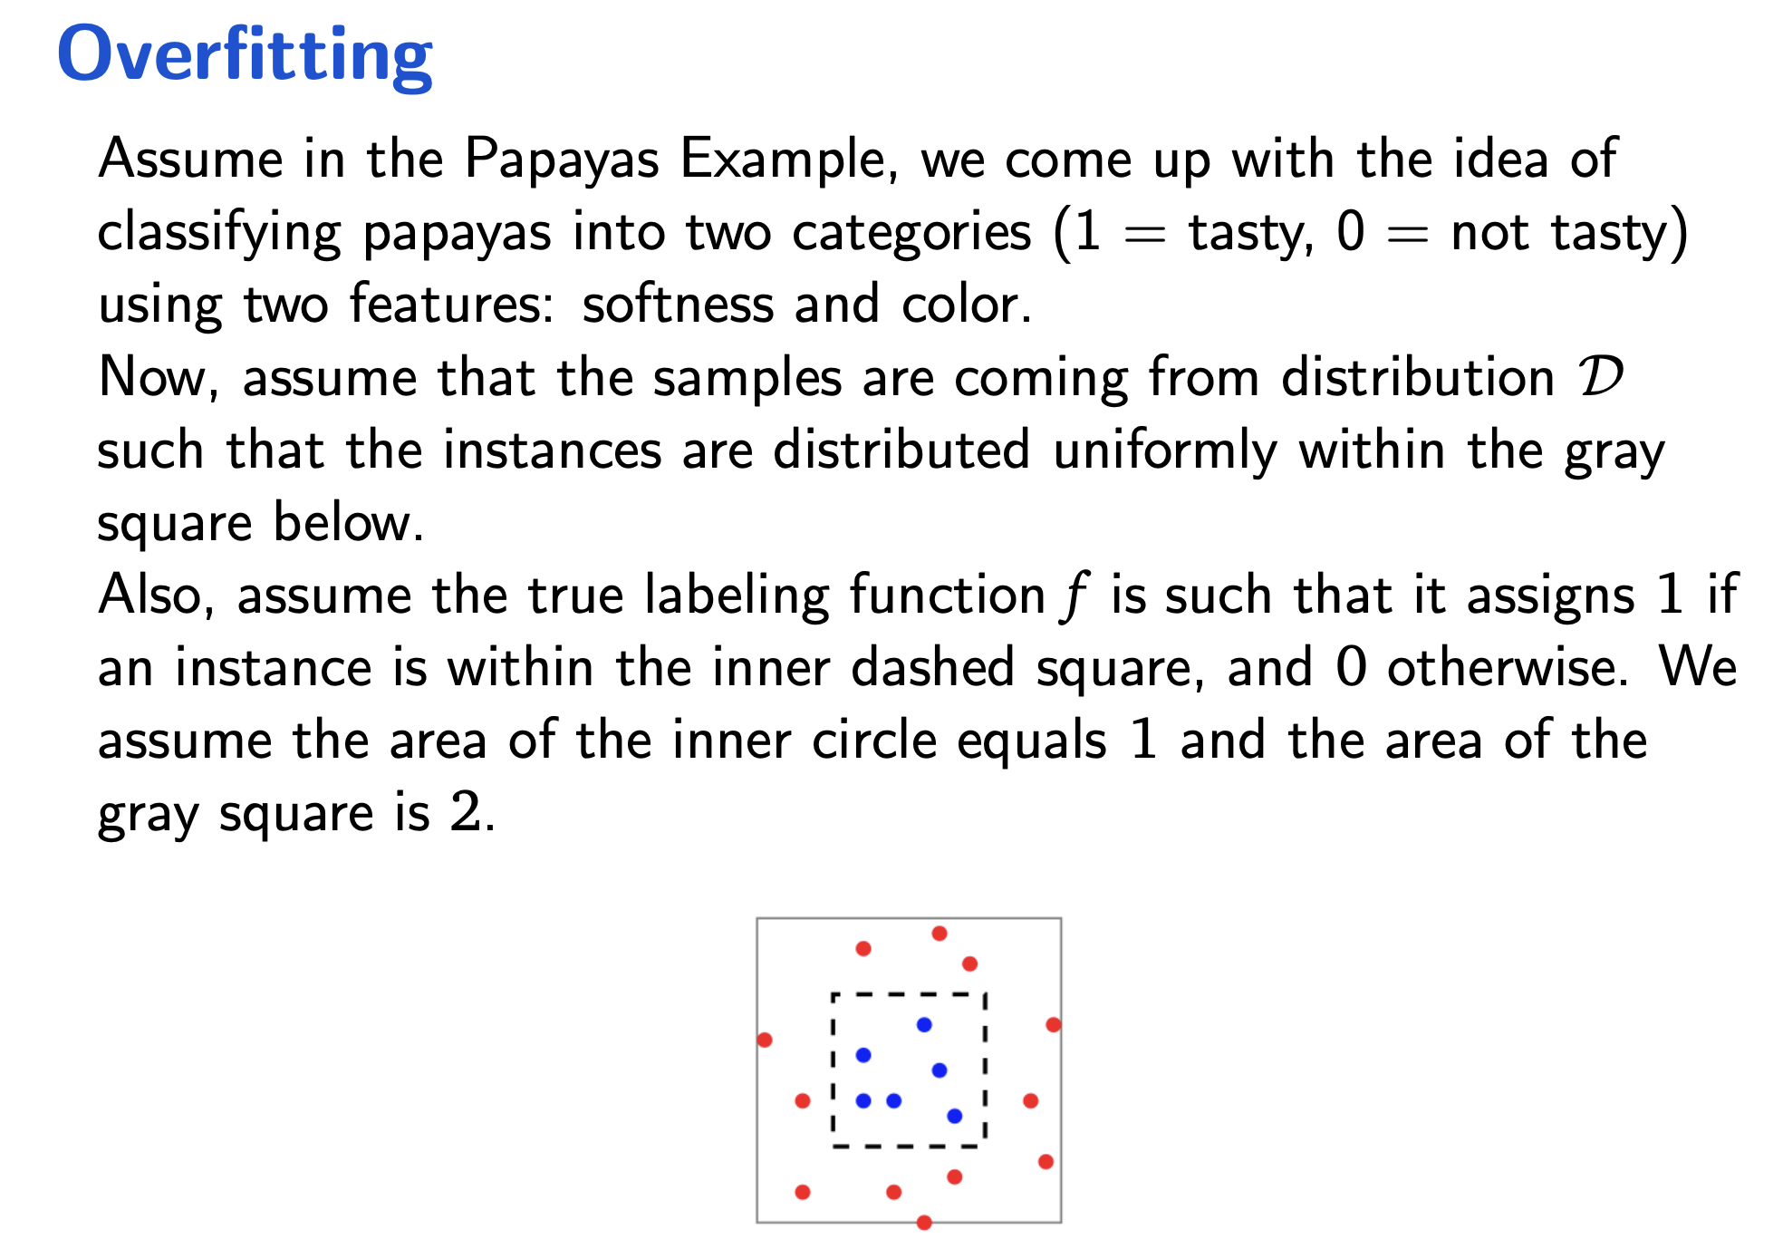
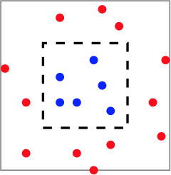
Overfitting
Assume in the Papayas Example, we come up with the idea of classifying papayas into two categories (1 = tasty, 0 = not tasty) using two features: softness and color.
Now, assume that the samples are coming from distribution D such that the instances are distributed uniformly within the gray square below.
Also, assume the true labeling function f is such that it assigns 1 if an instance is within the inner dashed square, and 0 otherwise. We assume the area of the inner circle equals 1 and the area of the gray square is 2.
12

Slide 59
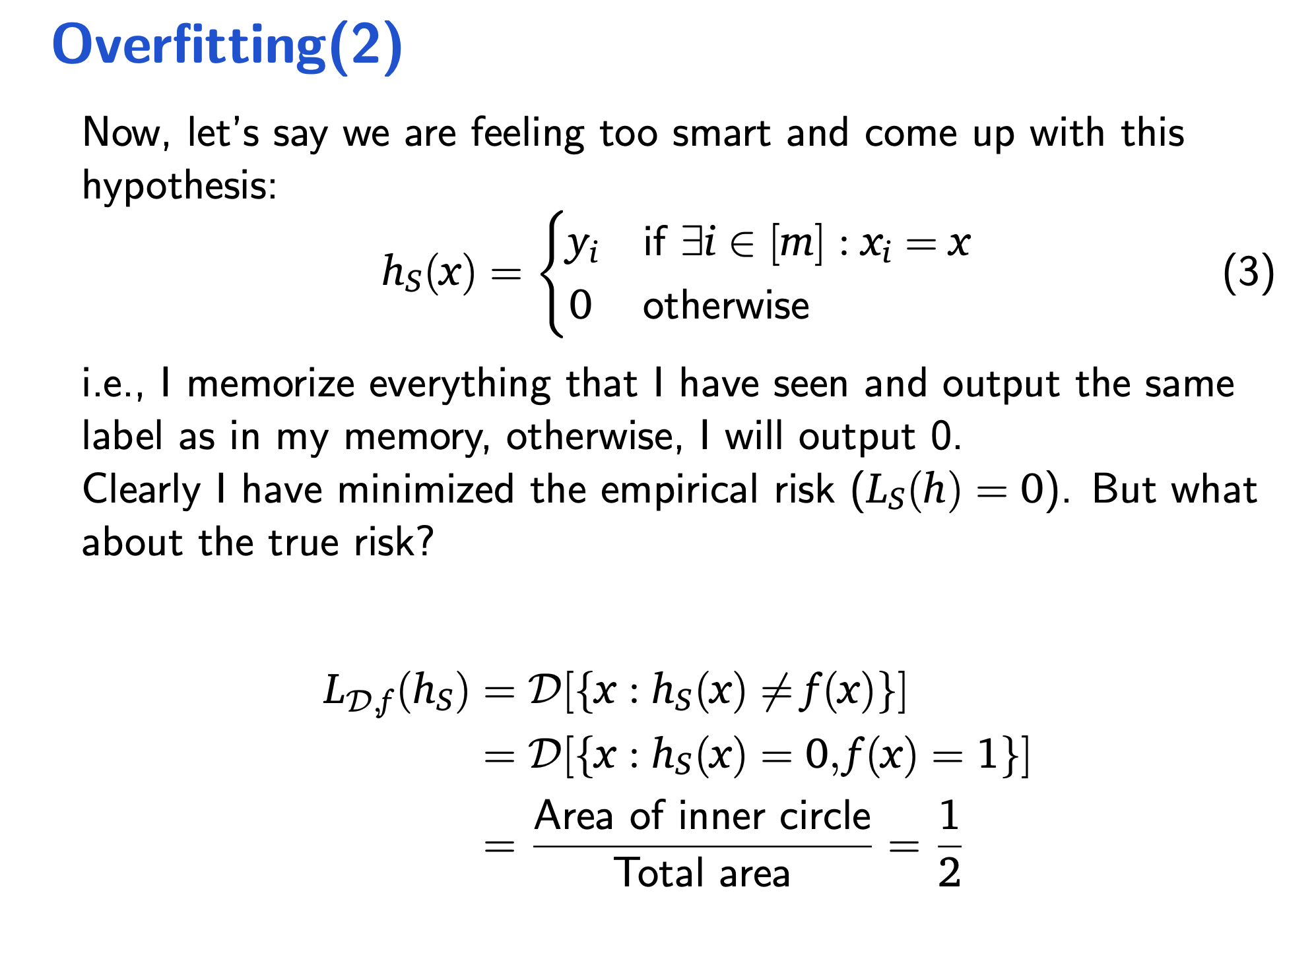
Overfitting(2)
Now, let’s say we are feeling too smart and come up with this hypothesis:
(
y if ∃i ∈ [m] : x_{i} = x
h (x) =
i
(3)
S
0 otherwise
i.e., I memorize everything that I have seen and output the same label as in my memory, otherwise, I will output 0.
Clearly I have minimized the empirical risk (L_{S}(h) = 0). But what about the true risk?
L_{D,f} (h_{S}) = D[{x : h_{S}(x) /= f (x)}]
= D[{x : h_{S}(x) = 0, f (x) = 1}]
Area of inner circle 1
=
=
Total area 2
13

Slide 60
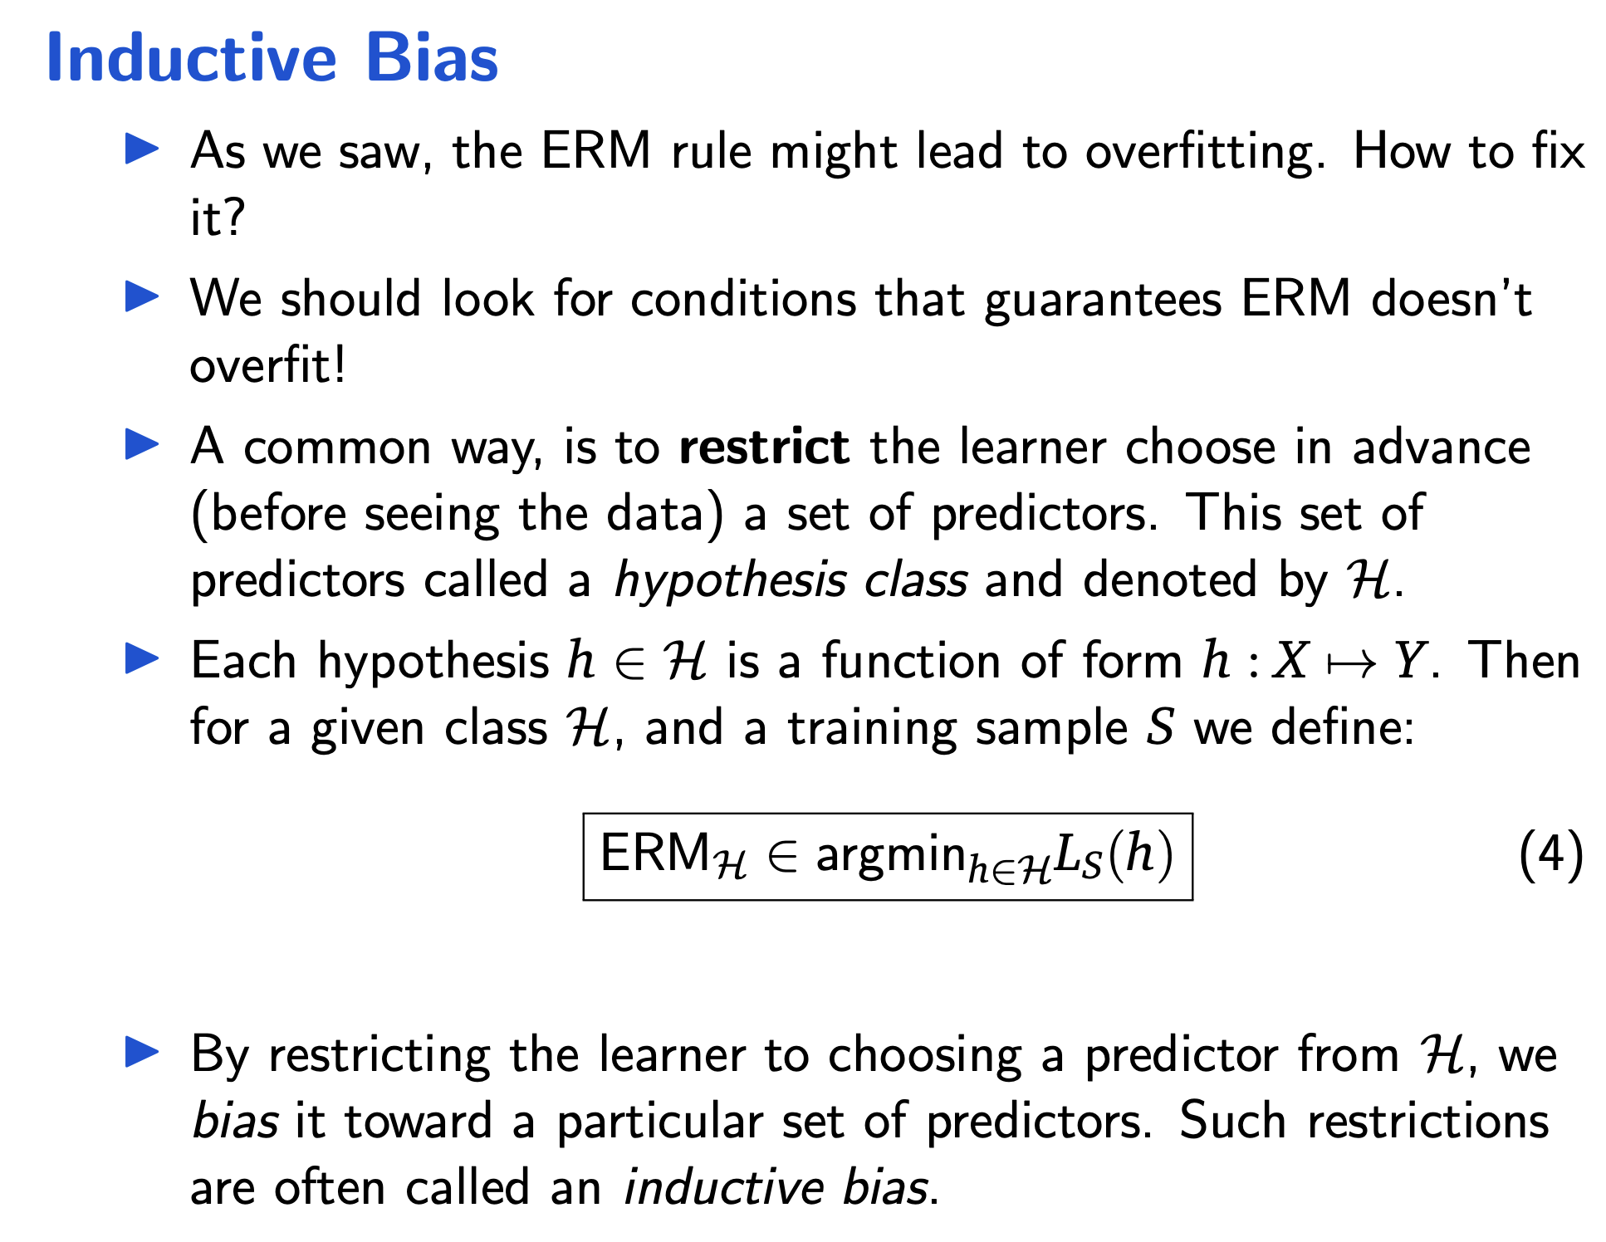
Inductive Bias
As we saw, the ERM rule might lead to overfitting. How to fix it?
We should look for conditions that guarantees ERM doesn’t overfit!
A common way, is to restrict the learner choose in advance (before seeing the data) a set of predictors. This set of predictors called a hypothesis class and denoted by H.
Each hypothesis h ∈ H is a function of form h : X ›→ Y. Then for a given class H, and a training sample S we define:
ERM_{H} ∈ argmin_{h∈H}L_{S}(h)
(4)
By restricting the learner to choosing a predictor from H, we bias it toward a particular set of predictors. Such restrictions are often called an inductive bias.

Slide 61
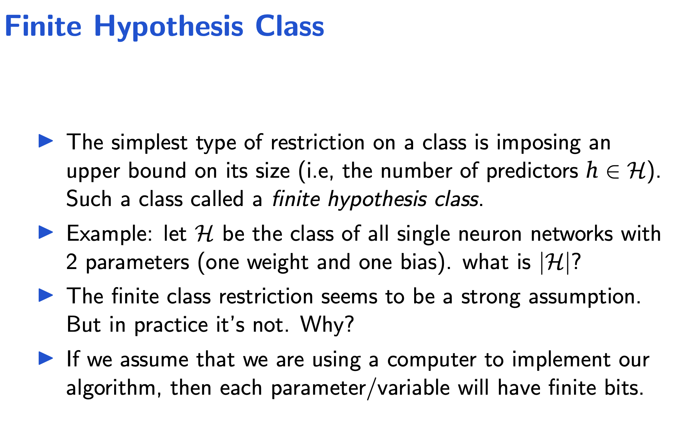
Finite Hypothesis Class
The simplest type of restriction on a class is imposing an upper bound on its size (i.e, the number of predictors h ∈ H). Such a class called a finite hypothesis class.
Example: let H be the class of all single neuron networks with 2 parameters (one weight and one bias). what is |H|?
The finite class restriction seems to be a strong assumption. But in practice it’s not. Why?
If we assume that we are using a computer to implement our algorithm, then each parameter/variable will have finite bits.
15

Slide 62
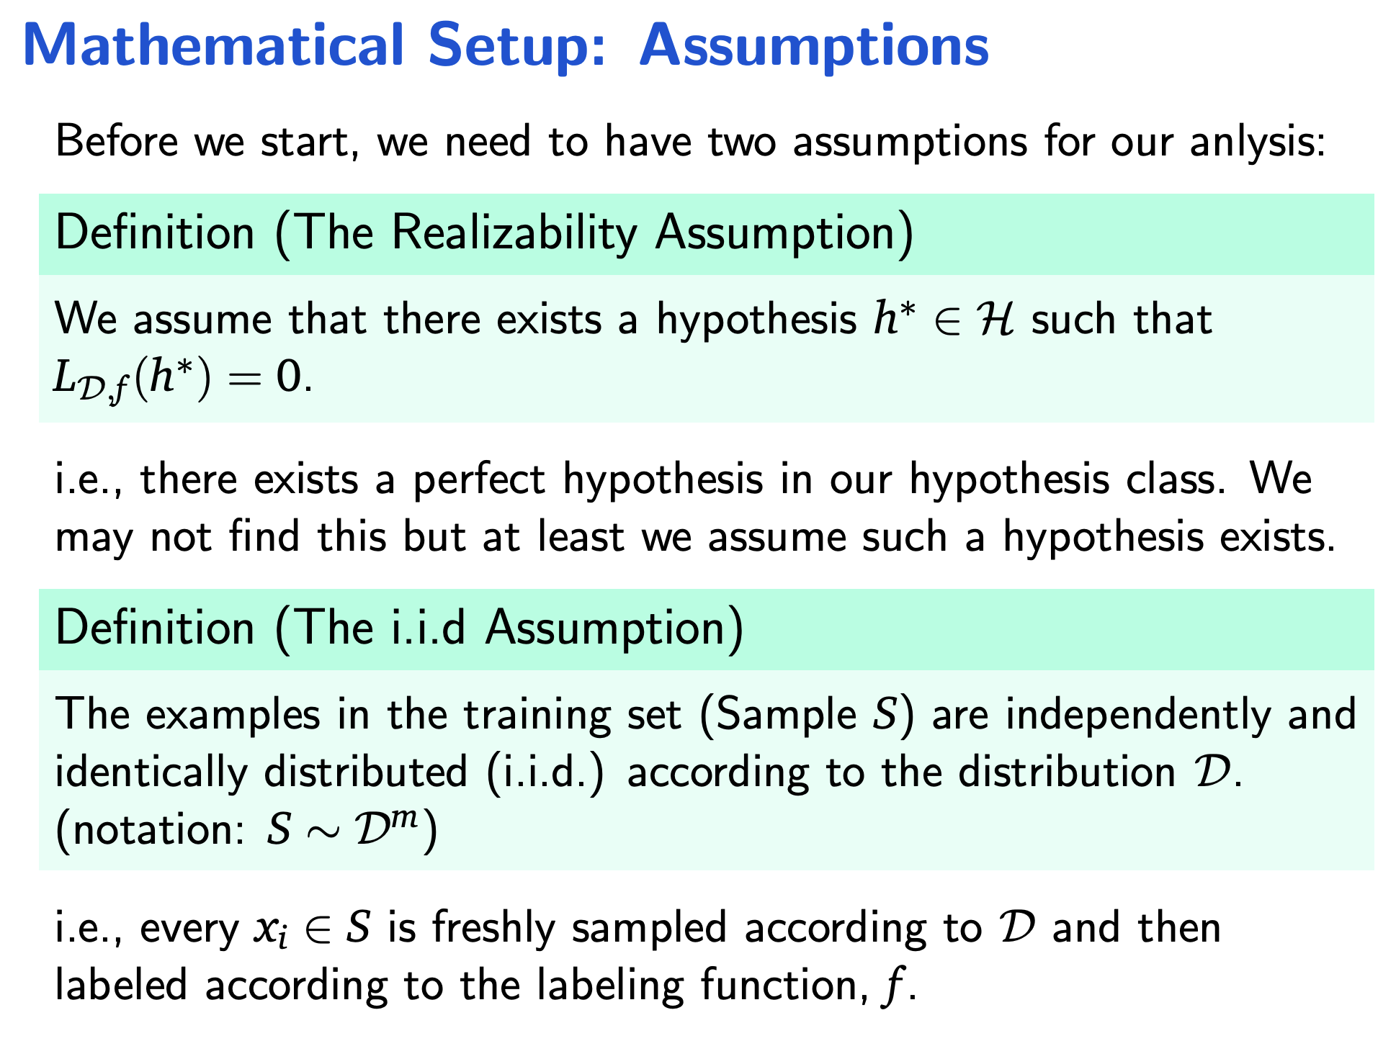
Mathematical Setup: Assumptions
Before we start, we need to have two assumptions for our anlysis:
Definition (The Realizability Assumption)
We assume that there exists a hypothesis h∗ ∈ H such that
L_{D,f} (h∗) = 0.
i.e., there exists a perfect hypothesis in our hypothesis class. We may not find this but at least we assume such a hypothesis exists.
Definition (The i.i.d Assumption)
The examples in the training set (Sample S) are independently and identically distributed (i.i.d.) according to the distribution D. (notation: S ∼ D^{m})
i.e., every x_{i} ∈ S is freshly sampled according to D and then labeled according to the labeling function, f .

Slide 63
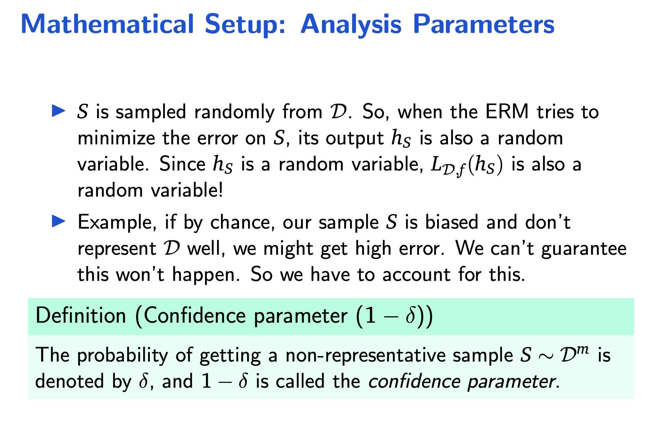
Mathematical Setup: Analysis Parameters
S is sampled randomly from D. So, when the ERM tries to minimize the error on S, its output h_{S} is also a random variable. Since h_{S} is a random variable, L_{D,f} (h_{S}) is also a random variable!
Example, if by chance, our sample S is biased and don’t represent D well, we might get high error. We can’t guarantee this won’t happen. So we have to account for this.
Definition (Confidence parameter (1 − δ))
The probability of getting a non-representative sample S ∼ D^{m} is denoted by δ, and 1 − δ is called the confidence parameter.
18

Slide 64
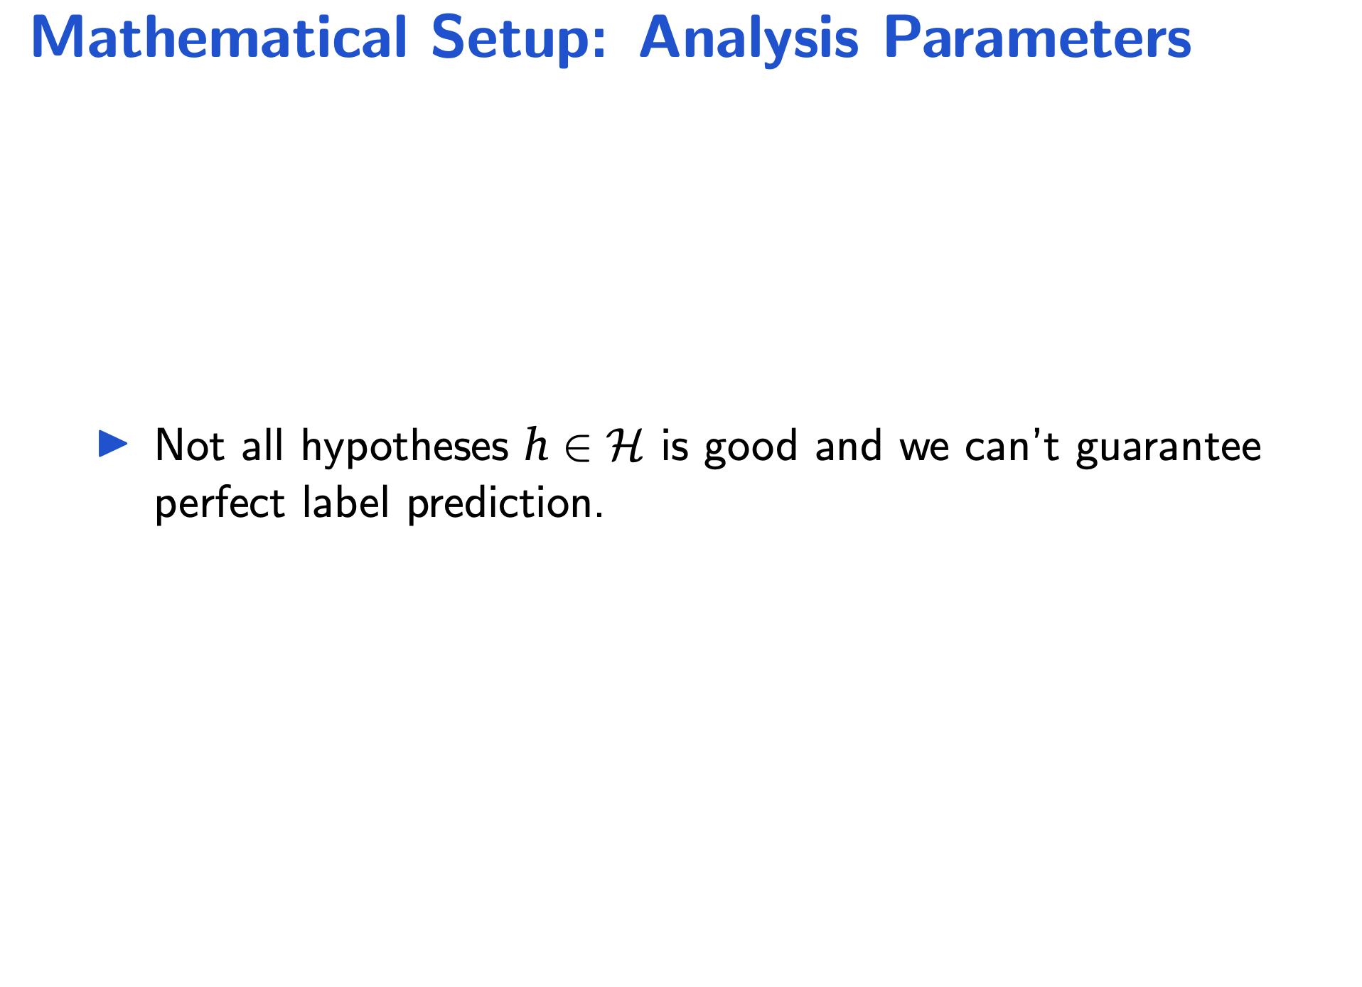
Mathematical Setup: Analysis Parameters
Not all hypotheses h ∈ H is good and we can’t guarantee perfect label prediction.

Slide 65
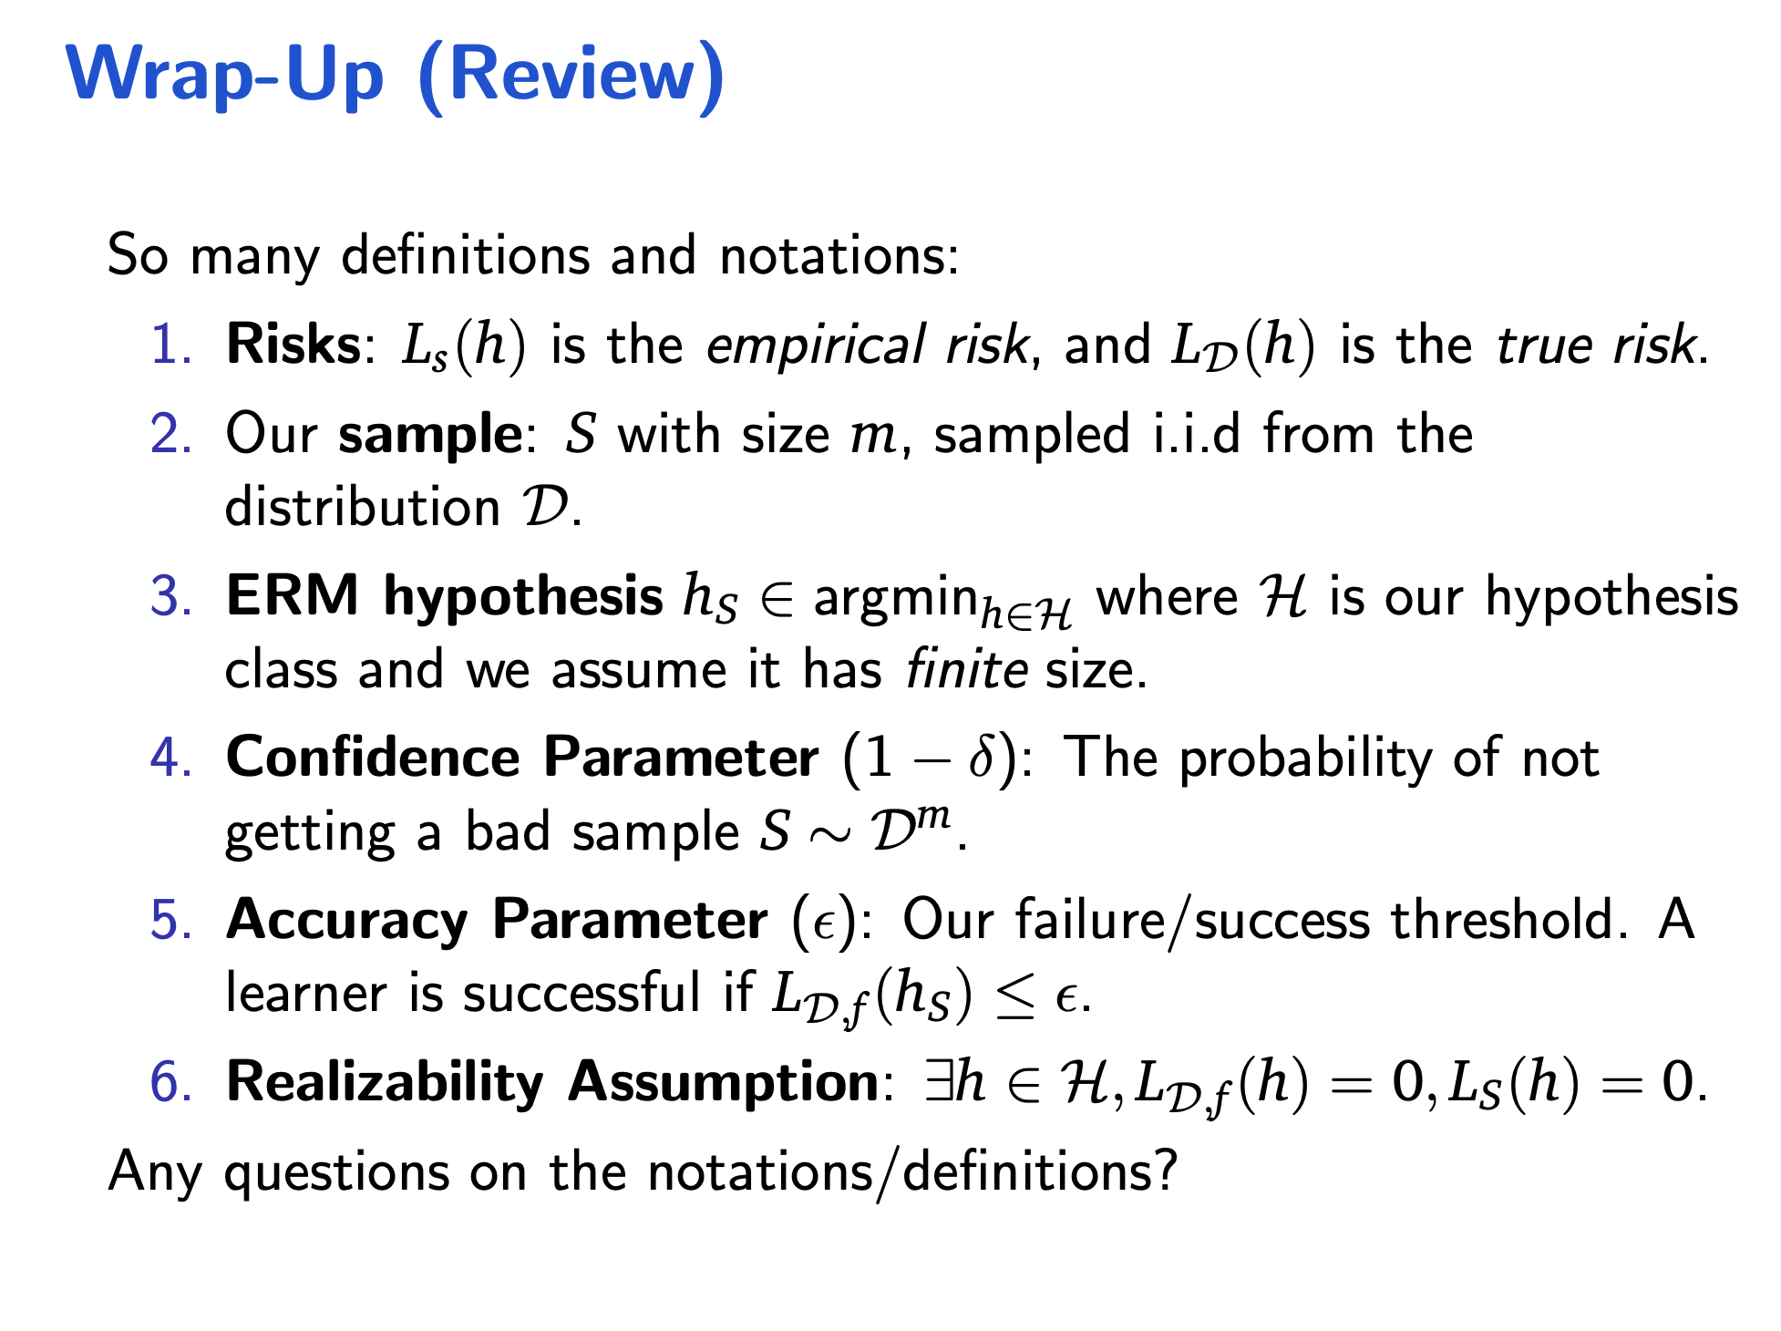
Wrap-Up (Review)
So many definitions and notations:
Risks: L_{s}(h) is the empirical risk, and L_{D}(h) is the true risk.
Our sample: S with size m, sampled i.i.d from the distribution D.
ERM hypothesis h_{S} ∈ argmin_{h∈H} where H is our hypothesis class and we assume it has finite size.
Confidence Parameter (1 −_{m} δ): The probability of not getting a bad sample S ∼ D .
Accuracy Parameter (ϵ): Our failure/success threshold. A learner is successful if L_{D,f} (h_{S}) ≤ ϵ.
Realizability Assumption: ∃h ∈ H, L_{D,f} (h) = 0, L_{S}(h) = 0. Any questions on the notations/definitions?

Slide 66
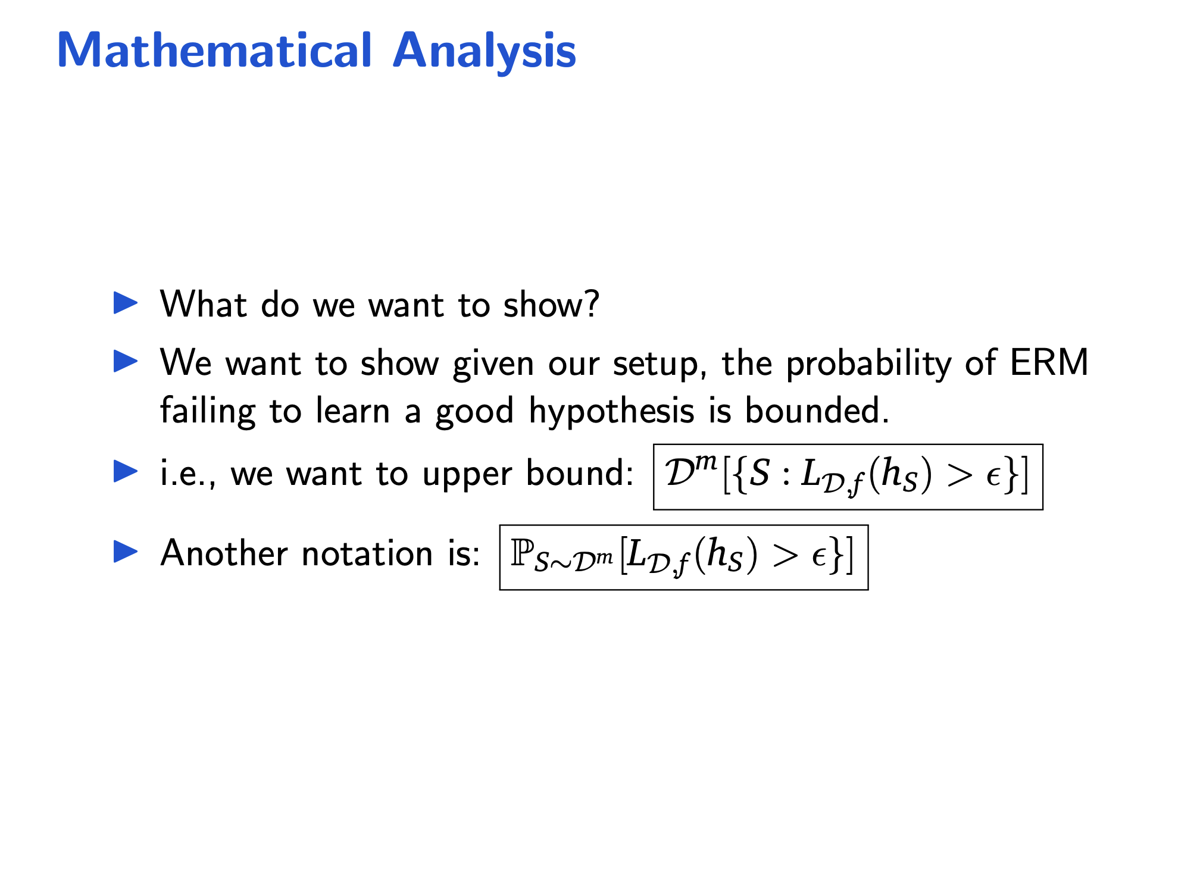
Mathematical Analysis
What do we want to show?
21

Slide 67
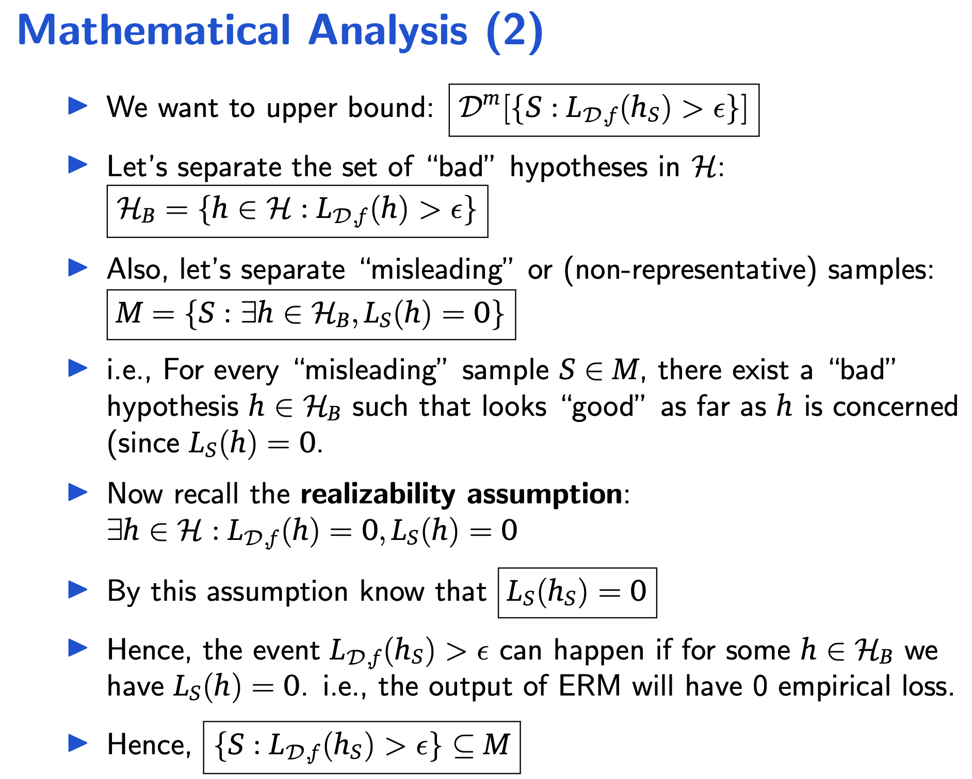
Mathematical Analysis (2)
We want to upper bound: D^{m}[{S : L_{D,f} (h_{S}) > ϵ}]
22

Slide 68
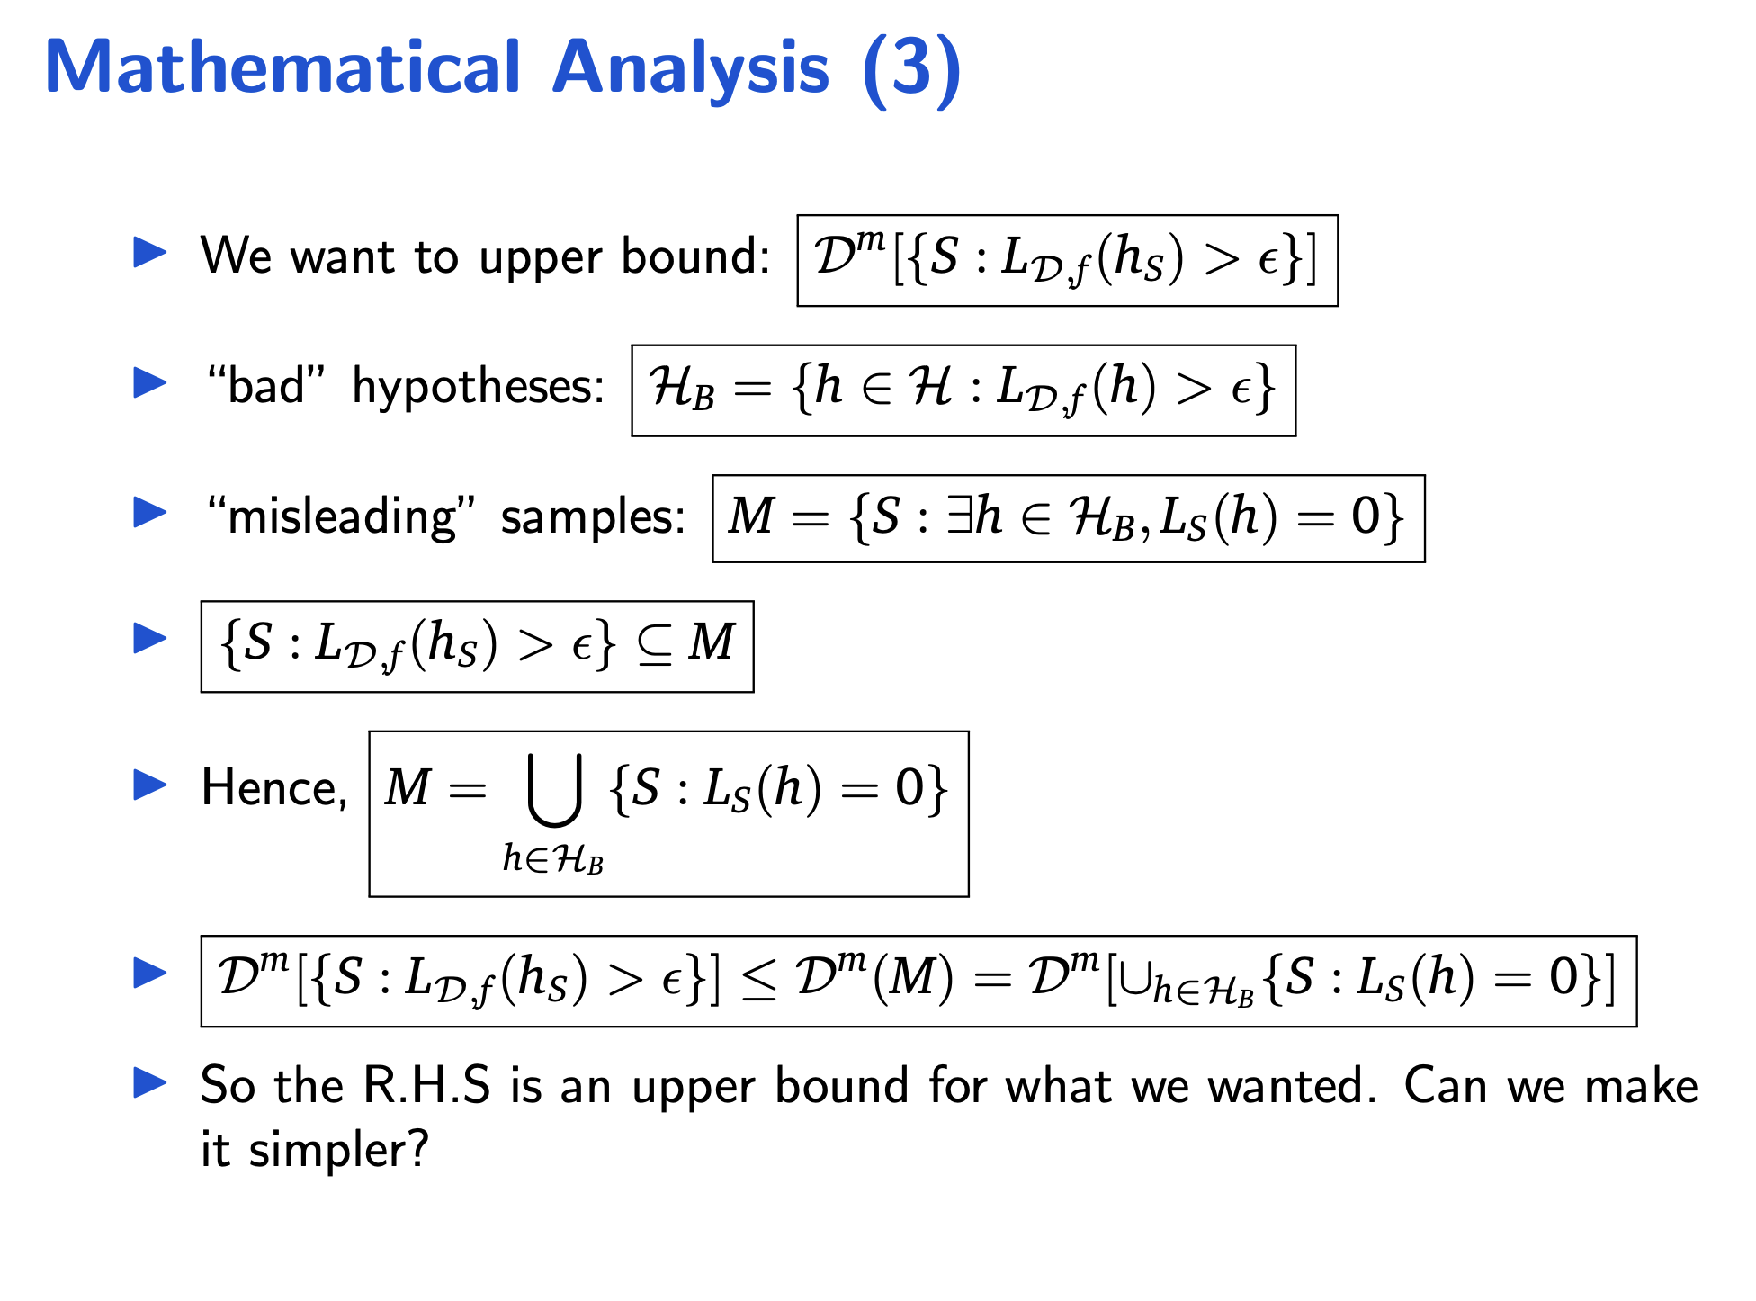
Mathematical Analysis (3)
We want to upper bound: D^{m}[{S : L_{D,f} (h_{S}) > ϵ}]
“bad” hypotheses: H_{B} = {h ∈ H : L_{D,f} (h) > ϵ}
“misleading” samples: M = {S : ∃h ∈ H_{B}, L_{S}(h) = 0}
{S : L_{D,f} (h_{S}) > ϵ} ⊆ M
[
Hence, M = {S : L (h
) = 0}
S
h∈HB
m m m
D [{S : L (h ) > ϵ}] ≤ D (M) = D [∪
{S : L (h) = 0}]
D,f S h∈H
B
S
So the R.H.S is an upper bound for what we wanted. Can we make it simpler?
23

Slide 69
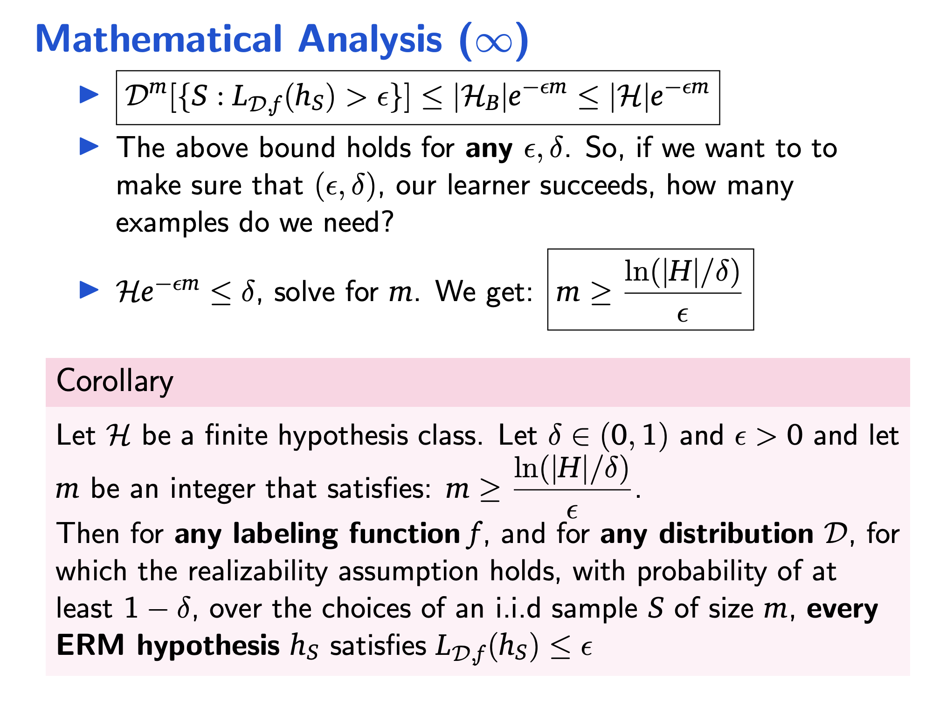
Mathematical Analysis (∞)
D^{m}[{S : L_{D,f} (h_{S}) > ϵ}] ≤ |H_{B}|e^{−єm} ≤ |H|e^{−єm}
The above bound holds for any ϵ, δ. So, if we want to to make sure that (ϵ, δ), our learner succeeds, how many examples do we need?
ln(|H|/δ)
He^{−єm} ≤ δ, solve for m. We get: m ≥
Corollary
ϵ
Let H be a finite hypothesis class. Let δ ∈ (0, 1) and ϵ > 0 and let
ln(|H|/δ)
m be an integer that satisfies: m ≥
.
ϵ
Then for any labeling function f , and for any distribution D, for
which the realizability assumption holds, with probability of at least 1 − δ, over the choices of an i.i.d sample S of size m, every ERM hypothesis h_{S} satisfies L_{D,f} (h_{S}) ≤ ϵ
25

Slide 70
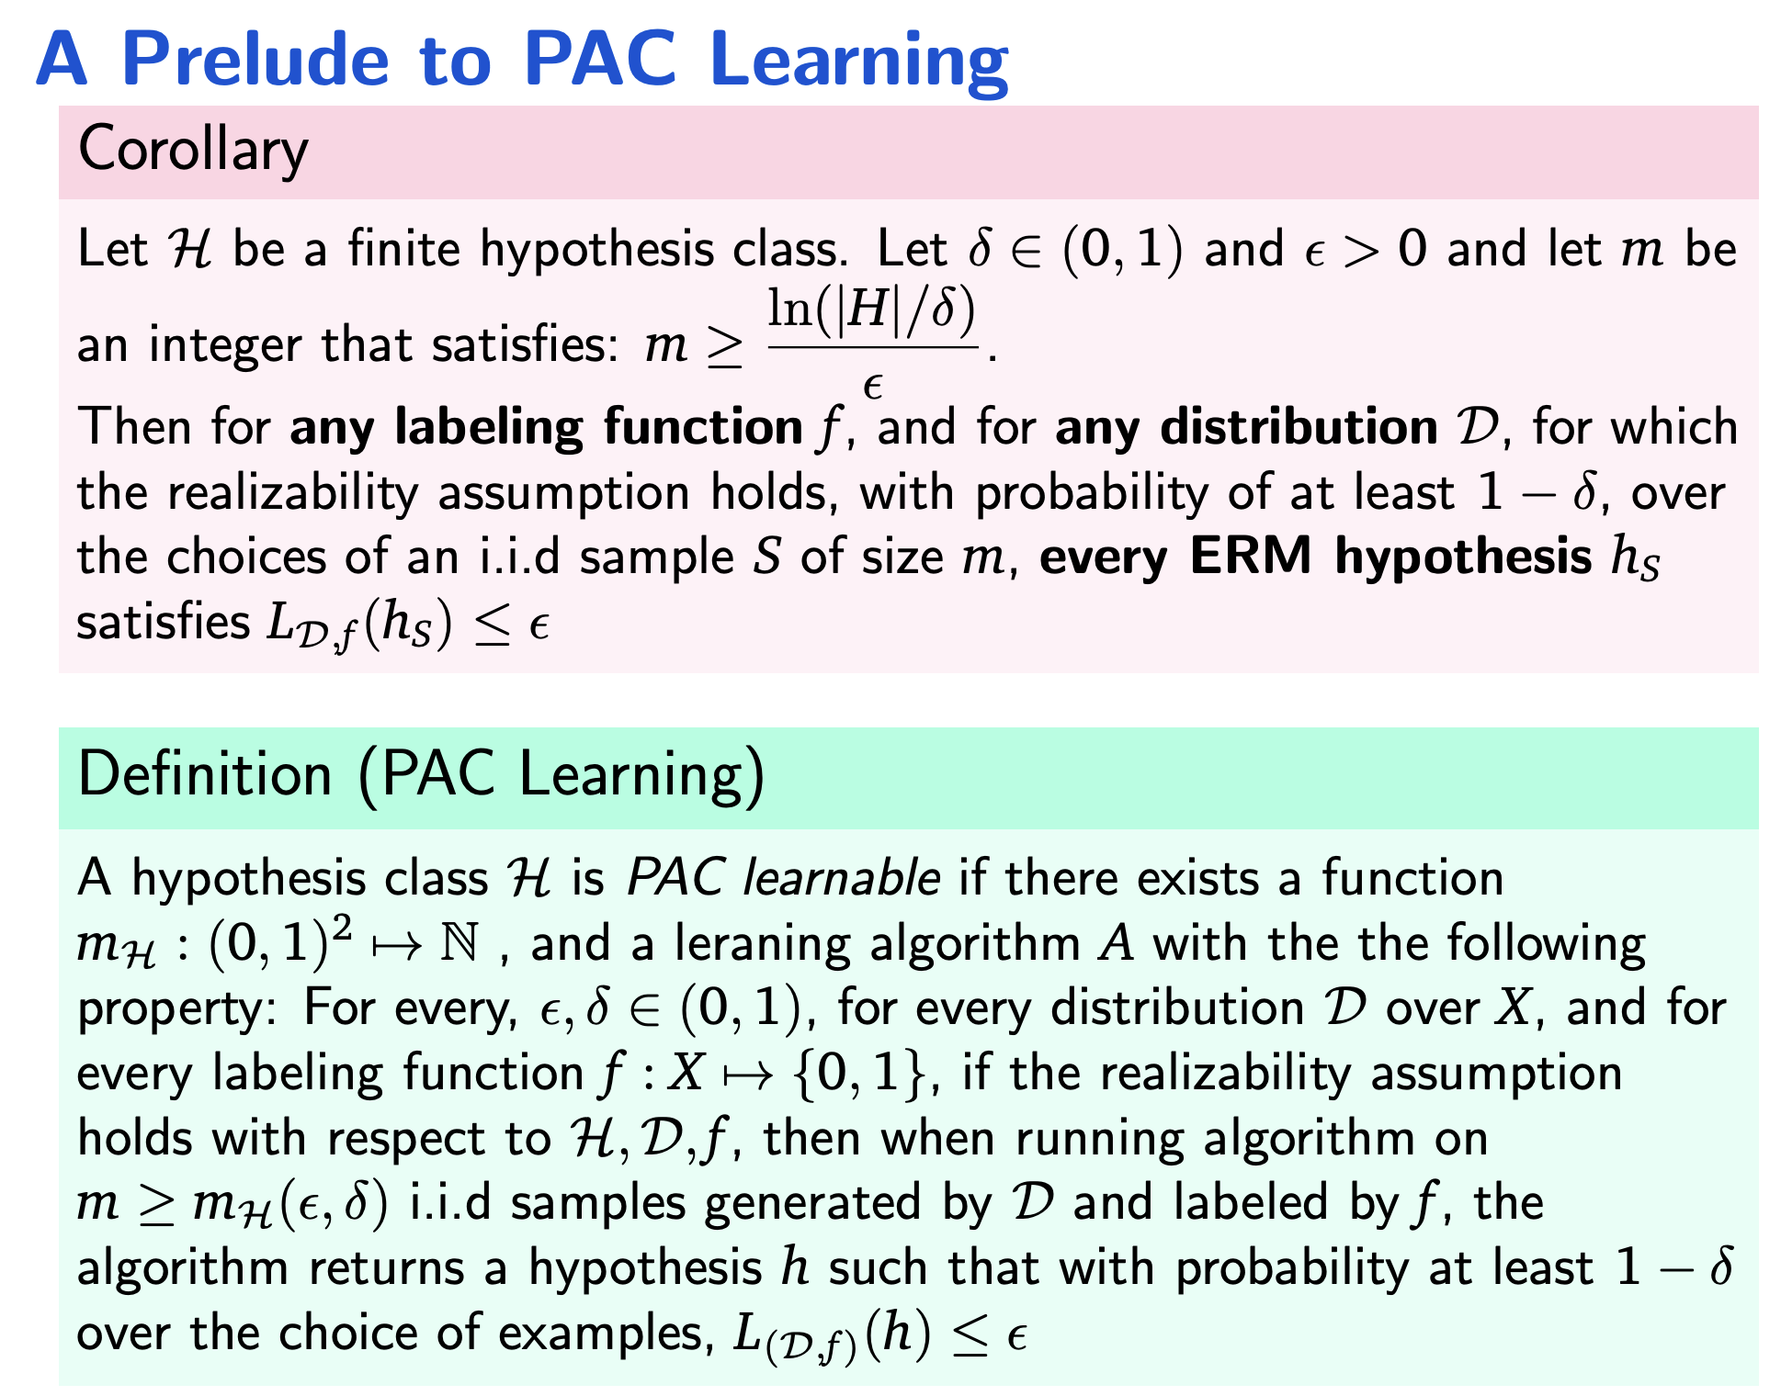
A Prelude to PAC Learning
Corollary
Let H be a finite hypothesis class. Let δ ∈ (0, 1) and ϵ > 0 and let m be
ln(|H|/δ)
an integer that satisfies: m ≥
.
ϵ
Then for any labeling function f , and for any distribution D, for which
the realizability assumption holds, with probability of at least 1 − δ, over the choices of an i.i.d sample S of size m, every ERM hypothesis h_{S} satisfies L_{D,f} (h_{S}) ≤ ϵ
Definition (PAC Learning)
A hypothesis class H is PAC learnable if there exists a function
m_{H} : (0, 1)² ›→ N , and a leraning algorithm A with the the following property: For every, ϵ, δ ∈ (0, 1), for every distribution D over X, and for every labeling function f : X ›→ {0, 1}, if the realizability assumption holds with respect to H, D, f , then when running algorithm on
m ≥ m_{H}(ϵ, δ) i.i.d samples generated by D and labeled by f , the
algorithm returns a hypothesis h such that with probability at least 1 − δ
over the choice of examples, L_{(D,f )}(h) ≤ ϵ
27

Slide 71
Building Good Training Sets

Slide 72
Why Data Preprocessing?
Data in the real world is dirty
incomplete: lacking attribute values, lacking certain attributes of interest, or containing only aggregate data
e.g., occupation=“”
noisy: containing errors or outliers
e.g., Salary=“-10”
inconsistent: containing discrepancies in codes or names
e.g., Age=“42” Birthday=“03/07/1997”
e.g., Was rating “1,2,3”, now rating “A, B, C”
e.g., discrepancy between duplicate records

Slide 73
Why Is Data Dirty?
Incomplete data comes from
n/a data value when collected
different consideration between the time when the data was collected and when it is analyzed.
human/hardware/software problems
Noisy data comes from the process of data
collection
entry
transmission
Inconsistent data comes from
Different data sources
Functional dependency violation

Slide 74
Why Is Data Preprocessing Important?
No quality data, no quality mining results!
Quality decisions must be based on quality data
e.g., duplicate or missing data may cause incorrect or even misleading statistics.
Data warehouse needs consistent integration of quality data
Data extraction, cleaning, and transformation comprises the majority of the work of building a data warehouse. —Bill Inmon

Slide 75
Major Tasks in Data Preprocessing
Data cleaning
Fill in missing values, smooth noisy data, identify or remove outliers, and resolve inconsistencies
Data integration
Integration of multiple databases, data cubes, or files
Data transformation
Normalization and aggregation
Data reduction
Obtains reduced representation in volume but produces the same or similar analytical results
Data discretization
Part of data reduction but with particular importance, especially for numerical data

Slide 76
Data Cleaning
Importance
“Data cleaning is one of the three biggest problems in data warehousing”—Ralph Kimball
“Data cleaning is the number one problem in data warehousing”—DCI survey
Data cleaning tasks
Fill in missing values
Identify outliers and smooth out noisy data
Correct inconsistent data
Resolve redundancy caused by data integration

Slide 77
Missing Data
Data is not always available
E.g., many tuples have no recorded value for several attributes, such as customer income in sales data
Missing data may be due to
equipment malfunction
inconsistent with other recorded data and thus deleted
data not entered due to misunderstanding
certain data may not be considered important at the time of entry
not register history or changes of the data
Missing data may need to be inferred.

Slide 78
How to Handle Missing Data?
Ignore the tuple: usually done when class label is missing (assuming the tasks in classification—not effective when the percentage of missing values per attribute varies considerably.
Fill in the missing value manually: tedious + infeasible?
Fill in it automatically with
a global constant : e.g., “unknown”, a new class?!
the attribute mean
the attribute mean for all samples belonging to the same class: smarter
the most probable value: inference-based such as Bayesian formula or decision tree

Slide 79
What is Data?
Collection of data objects and their attributes
An attribute is a property or characteristic of an object
Examples: eye color of a person, temperature, etc.
Attribute is also known as variable, field, characteristic, or feature
A collection of attributes describe an object
Object is also known as record, point, case, sample, entity, or instance
Attributes
Objects

Slide 80
Attribute Values
Attribute values are numbers or symbols assigned to an attribute
Distinction between attributes and attribute values
Same attribute can be mapped to different attribute values
Example: height can be measured in feet or meters
Different attributes can be mapped to the same set of values
Example: Attribute values for ID and age are integers
But properties of attribute values can be different
ID has no limit but age has a maximum and minimum value

Slide 81
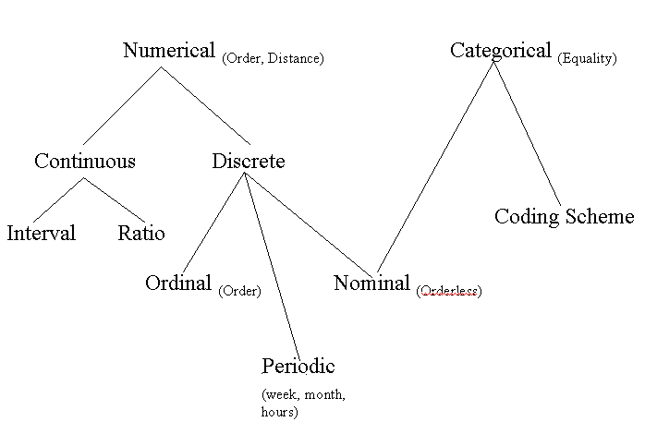
Data Types and Forms
Attribute-value data:
Data types
numeric, categorical (see the hierarchy for its relationship)
static, dynamic (temporal)
Other kinds of data
distributed data
text, Web, meta data
images, audio/video

Slide 82
Types of data
Categorical data
Measurement data

Slide 83
Categorical Data
The objects being studied are grouped into categories based on some qualitative trait.
The resulting data are merely labels or categories.

Slide 84
Examples: Categorical Data
Hair color
blonde, brown, red, black, etc.
Smoking status
smoker, non-smoker

Slide 85
Categorical data classified as Nominal, Ordinal, and/or Binary
Categorical data
Nominal
data
Ordinal
data
Binary
Not binary
Binary
Not binary

Slide 86
Nominal Data
A type of categorical data in which objects fall into unordered categories.
Nominal data represents categories with no inherent order or ranking. Each category is distinct, and there is no meaningful way to compare the categories in terms of magnitude or value.

Slide 87
Examples: Nominal Data
Hair color
blonde, brown, red, black, etc.
Race
Caucasian, African-American, Asian, etc.
Smoking status
smoker, non-smoker

Slide 88
Ordinal Data
A type of categorical data in which order is important.
While the categories have a clear order, the intervals between them may not be uniform or meaningful.

Slide 89
Examples: Ordinal Data
Class
fresh, sophomore, junior, senior, super senior
Degree of illness
none, mild, moderate, severe, …, going, going, gone
Opinion of students about riots
ticked off, neutral, happy

Slide 90
Binary Data
A type of categorical data in which there are only two categories.
Binary data can either be nominal or ordinal.
Binary data is a subtype of categorical data where each observation falls into one of two categories. It is a special case of nominal data with only two possible categories.

Slide 91
Examples: Binary Data
Smoking status
smoker, non-smoker
Attendance
present, absent

Slide 92
Measurement Data
The objects being studied are “measured” based on some quantitative trait.
The resulting data are set of numbers.

Slide 93
Examples: Measurement Data
Cholesterol level
Height
Age
SAT score
Number of students late for class
Time to complete a homework assignment

Slide 94
Measurement data classified as Discrete or Continuous
Measurement
data
Discrete
Continuous

Slide 95
Discrete Measurement Data
Only certain values are possible (there are gaps between the possible values).
Continuous Measurement Data
Theoretically, any value within an interval is possible with a fine enough measuring device.

Slide 96
Discrete data -- Gaps between possible values
0 1 2 3 4 5 6 7
Continuous data -- Theoretically,
no gaps between possible values
0 1000

Slide 97
Examples: Discrete Measurement Data
SAT scores
Number of students late for class
Number of crimes reported to SC police
Number of times the word number is used
Generally, discrete data are counts.

Slide 98
Examples: Continuous Measurement Data
Cholesterol level
Height
Age
Time to complete a homework assignment
Generally, continuous data come from measurements.

Slide 99
Who Cares?
The type(s) of data collected in a study determine the type of statistical analysis used.

Slide 100
For example ...
Categorical data are commonly summarized using “percentages” (or “proportions”).
11% of students have a tattoo
2%, 33%, 39%, and 26% of the students in class are, respectively, freshmen, sophomores, juniors, and seniors

Slide 101
And for example …
Measurement data are typically summarized using “averages” (or “means”).
Average number of siblings Fall 1998 Stat 250 students have is 1.9.
Average weight of male Fall 1998 Stat 250 students is 173 pounds.
Average weight of female Fall 1998 Stat 250 students is 138 pounds.

Slide 102

Attribute Type
Description
Examples
Operations
Nominal
The values of a nominal attribute are just different names, i.e., nominal attributes provide only enough information to distinguish one object from another. (=, ≠)
zip codes, employee ID numbers, eye color, sex: {male, female}
mode, entropy, contingency correlation, χ² test
Ordinal
The values of an ordinal attribute provide enough information to order objects. (<, >)
hardness of minerals, {good, better, best}, grades, street numbers
median, percentiles, rank correlation, run tests, sign tests
Interval
For interval attributes, the differences between values are meaningful, i.e., a unit of measurement exists. (+, - )
calendar dates, temperature in Celsius or Fahrenheit
mean, standard deviation, Pearson's correlation, t and F tests
Ratio
For ratio variables, both differences and ratios are meaningful. (*, /)
temperature in Kelvin, monetary quantities, counts, age, mass, length, electrical current
geometric mean, harmonic mean, percent variation

Slide 103
Evaluation and Credibility
How much should we believe in what was learned?

Slide 104
Introduction
How predictive is the model we learned?
Error on the training data is not a good indicator of performance on future data
Q: Why?
A: Because new data will probably not be exactly the same as the training data!
Overfitting – fitting the training data too precisely - usually leads to poor results on new data

Slide 105
Evaluation issues
Possible evaluation measures:
Classification Accuracy
Total cost/benefit – when different errors involve different costs
Error in numeric predictions
How reliable are the predicted results ?

Slide 106
Classifier error rate
Natural performance measure for classification problems: error rate
Success: instance’s class is predicted correctly
Error: instance’s class is predicted incorrectly
Error rate: proportion of errors made over the whole set of instances
Training set error rate: is way too optimistic!
you can find patterns even in random data

Slide 107
Evaluation on “LARGE” data
If many (thousands) of examples are available, including several hundred examples from each class, then a simple evaluation is sufficient
Randomly split data into training and test sets (usually 2/3 for train, 1/3 for test)
Build a classifier using the train set and evaluate it using the test set.

Slide 108
Classification Step 1: Split data into train and test sets
THE PAST
Results Known
+
Training set
+
-
-
Data
+
Testing set

Slide 109
Classification Step 2: Build a model on a training set
THE PAST
Results Known
+
Training set
+
-
-
Data
+
Model Builder
Testing set

Slide 110
Classification Step 3: Evaluate on test set
Results Known
+
Training set
+
-
-
Data
+
Model Builder
Evaluate
Predictions
+
-
+
-
Y
N
Testing set

Slide 111
Handling unbalanced data
Sometimes, classes have very unequal frequency
Attrition prediction: 97% stay, 3% attrite (in a month)
medical diagnosis: 90% healthy, 10% disease
eCommerce: 99% don’t buy, 1% buy
Security: >99.99% of Americans are not terrorists
Similar situation with multiple classes
Majority class classifier can be 97% correct, but useless

Slide 112
Balancing unbalanced data
With two classes, a good approach is to build BALANCED train and test sets, and train model on a balanced set
randomly select desired number of minority class instances
add equal number of randomly selected majority class
Generalize “balancing” to multiple classes
Ensure that each class is represented with approximately equal proportions in train and test

Slide 113
A note on parameter tuning
It is important that the test data is not used in any way to create the classifier
Some learning schemes operate in two stages:
Stage 1: builds the basic structure
Stage 2: optimizes parameter settings
The test data can’t be used for parameter tuning!
Proper procedure uses three sets: training data, validation data, and test data
Validation data is used to optimize parameters
witten & eibe

Slide 114
Making the most of the data
Once evaluation is complete, all the data can be used to build the final classifier
Generally, the larger the training data the better the classifier (but returns diminish)
The larger the test data the more accurate the error estimate
witten & eibe

Slide 115
Classification: Train, Validation, Test split
Results Known
+
Model
Builder
+
Training set
-
-
Data
+
Evaluate
Model Builder
Predictions
+
-
+
-
Y
N
Validation set
+
-
+
-
Final Evaluation
Final Test Set
Final Model

Slide 116
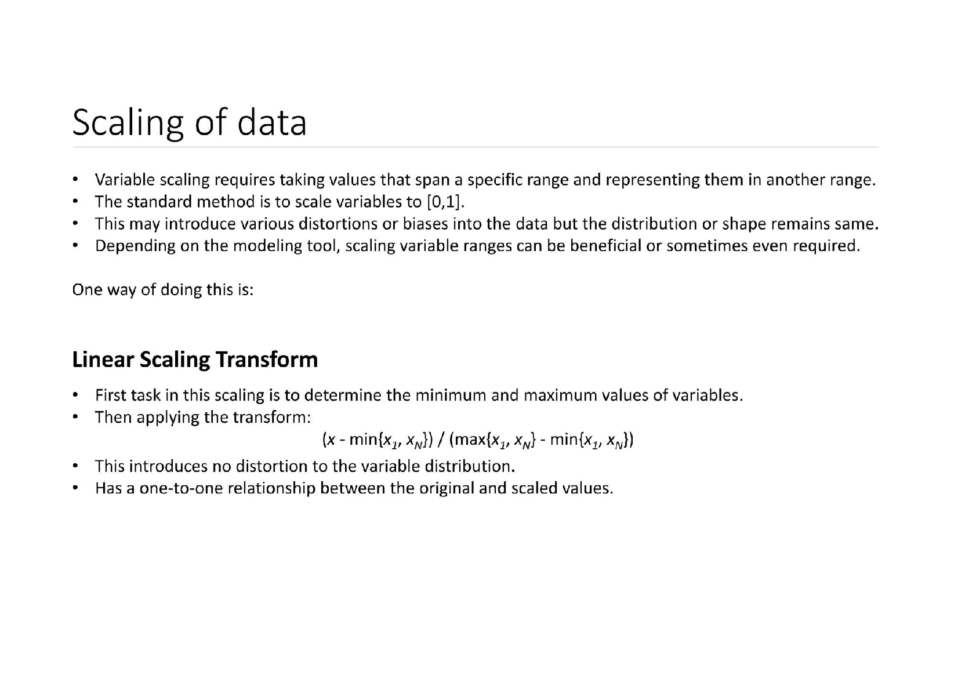

Slide 117
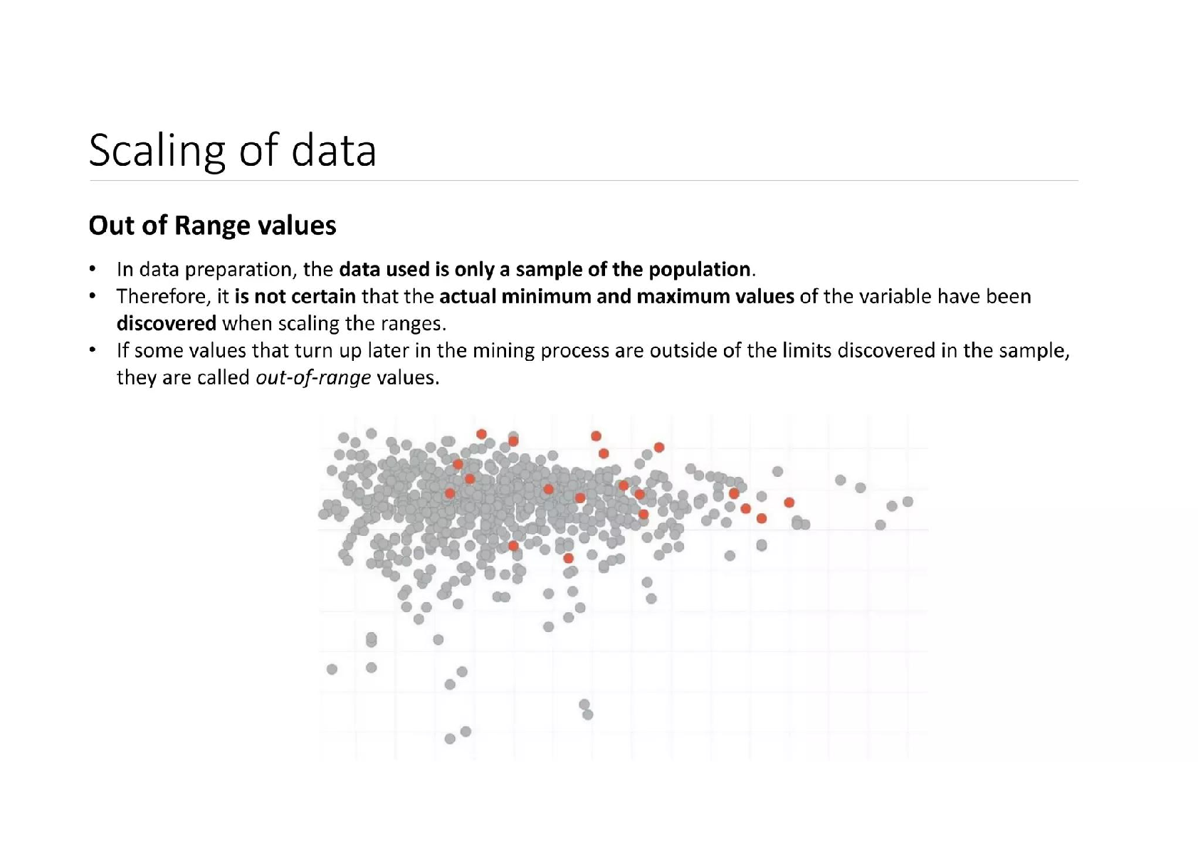

Slide 118


Slide 119


Slide 120


Slide 121



Slide 122

Data normalization involves applying a function to each data point in a dataset to transform the values in a way that not only scales the data but also changes its shape or distribution.

Slide 123


Slide 124


Slide 125


Slide 126
Feature Selection and Feature Reduction
Given n original features, it is often advantageous to reduce this to a smaller set of features for actual training
Can improve/maintain accuracy if we can preserve the most relevant information while discarding the most irrelevant information
And/or can make the learning process more computationally and algorithmically manageable by working with less features
Curse of dimensionality requires an exponential increase in data set size in relation to the number of features to learn without overfit – thus decreasing features can be critical
Feature Selection seeks a subset of the n original features which retains most of the relevant information
Filters, Wrappers
Feature Reduction combines/fuses the n original features into a smaller set of newly created features which hopefully retains most of the relevant information from all the original features - Data fusion (e.g. LDA, PCA, etc.)

Slide 127
Feature Selection - Filters
Given n original features, how do you select size of subset
User can preselect a size p (< n) – not usually as effective
Usually try to find the smallest size where adding more features does not yield improvement
Filters work independent of any particular learning algorithm
Filters seek a subset of features which maximize some type of between class separability – or other merit score
Can score each feature independently and keep best subset
e.g. 1st order correlation with output, fast, less optimal
Can score subsets of features together
Exponential number of subsets requires a more efficient, sub-optimal search approach
How to score features is independent of the ML model to be trained on and is an important research area
Decision Tree or other ML model pre-process
Notes:
1st order problem (xor example)
segue way into wrappers by asking what is "dumb" alg for best features subset for a "specific alg/task" (highlight the specific alg difference)

Slide 128
Feature Selection - Wrappers
Optimizes for a specific learning algorithm
The feature subset selection algorithm is a "wrapper" around the learning algorithm
Pick a feature subset and pass it to learning algorithm
Create training/test set based on the feature subset
Train the learning algorithm with the training set
Find accuracy (objective) with validation set
Repeat for all feature subsets and pick the feature subset which gives the highest predictive accuracy (or other objective)
Basic approach is simple
Variations are based on how to select the feature subsets, since there are an exponential number of subsets
Notes:
You may use – know this one well

Slide 129
Feature Selection - Wrappers
Exhaustive Search - Exhausting
Forward Search – O(n² · learning/testing time) - Greedy
Score each feature by itself and add the best feature to set FS (FS will be our final Feature Set) the initially empty
Try each subset consisting of the current FS plus one remaining feature and add the best feature to FS
Continue until stop getting significant improvement (over a window)
Backward Search – O(n² · learning/testing time) - Greedy
Score the initial complete FS
Try each subset consisting of the current FS minus one feature in FS and drop the feature from FS causing least decrease in accuracy
Continue until dropping any feature causes a significant decreases in accuracy
Branch and Bound and other heuristic approaches available
Notes:
Forward search could miss important higher order combinations. Backward search more robust to the higher order problem, since acc will drop if we drop an important feature which may have not been selected in forward.
Show a little example of each with values for 4 total features and when it would stop.

